Slide 1
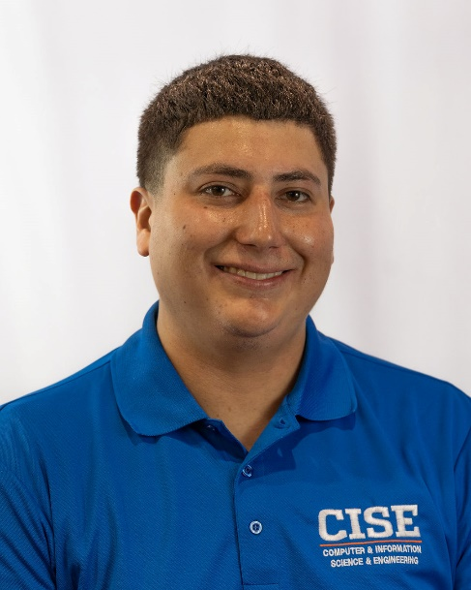
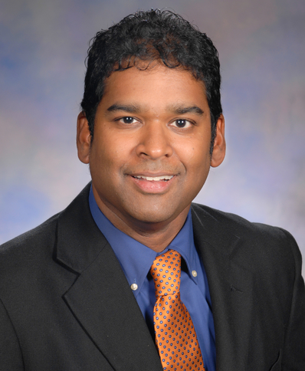
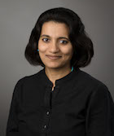
Let’s SOUP up XR: Collected thoughts from an IEEE VR workshop on privacy in mixed reality
Brendan David-John
University of Florida
Diane Hosfelt
Independent Researcher
Kevin Butler
University of Florida
Eakta Jain
University of Florida
Web: https://jainlab.cise.ufl.edu/PrXR_2021.html Email: brendanjohn@ufl.edu

Slide 2
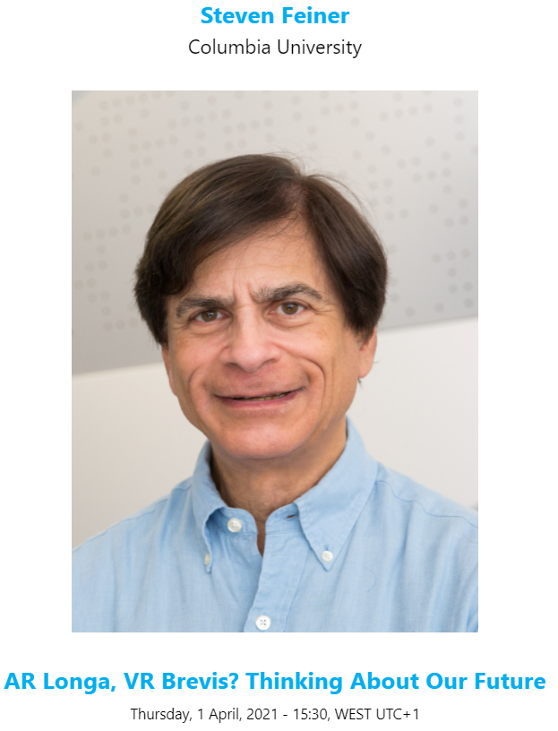
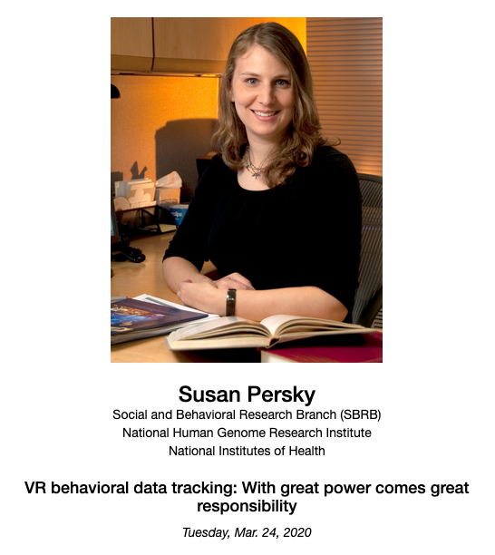
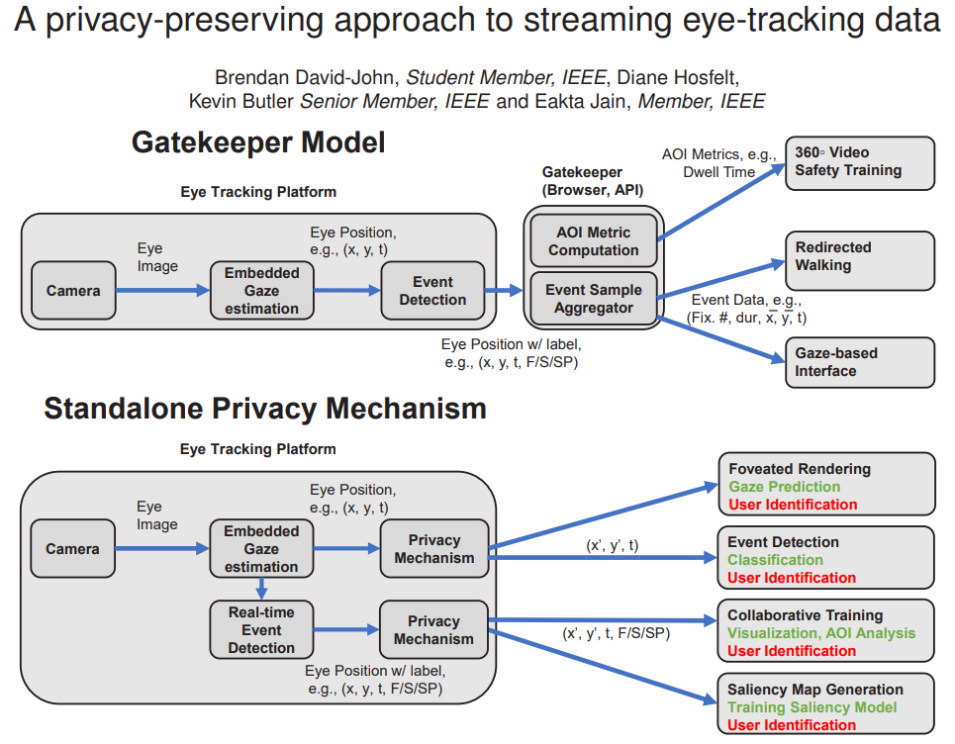
Motivation
VR 2020 Keynote
Ethics Workshop
VR 2021 Keynote
VR 2021 Awards
VR 2021 Paper

Slide 3
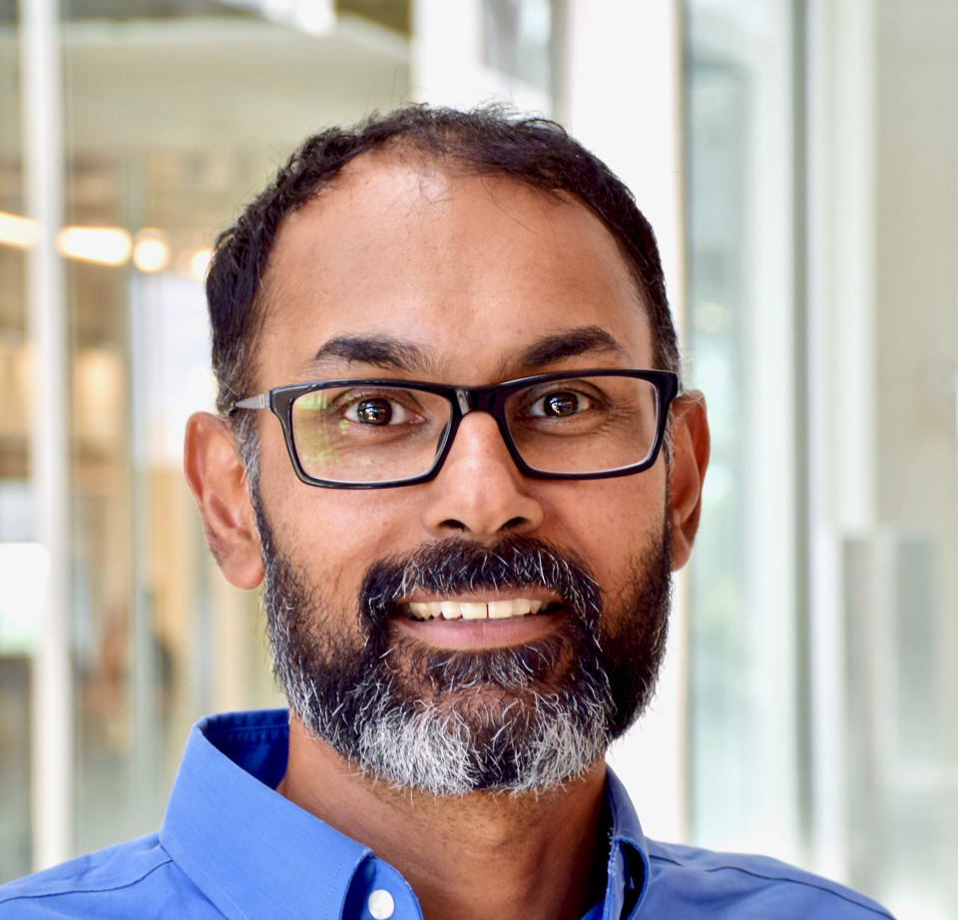
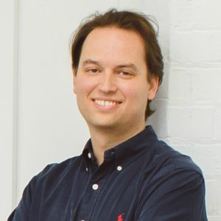
PrXR Workshop @ IEEE VR 2021
Panelists
Panel Discussion & Q/A
Two position papers
Three Breakout Discussions:
Behavioral Data
Scene Content
Bystander Privacy
101 registered attendees
Mailing list: PRIVACY-AND-SECURITY-XR-L
Enkeledja Kasneci
Blair McIntyre
Apu Kapadia
Ivan Martinovic

Slide 4
Paper and Panel Discussion Insights
Researcher Responsibilities
Challenges from Immersion
Risks from
Large-Scale Data Collection
Ethics curricula for HCI
Certifications and standards are needed
[Happa, Steed, & Glencross]
Impression Management
Personal space
[Buck & Bodenheimer]
Deep ML models
Multi-modal sensor data
Unintended inferences

Slide 5
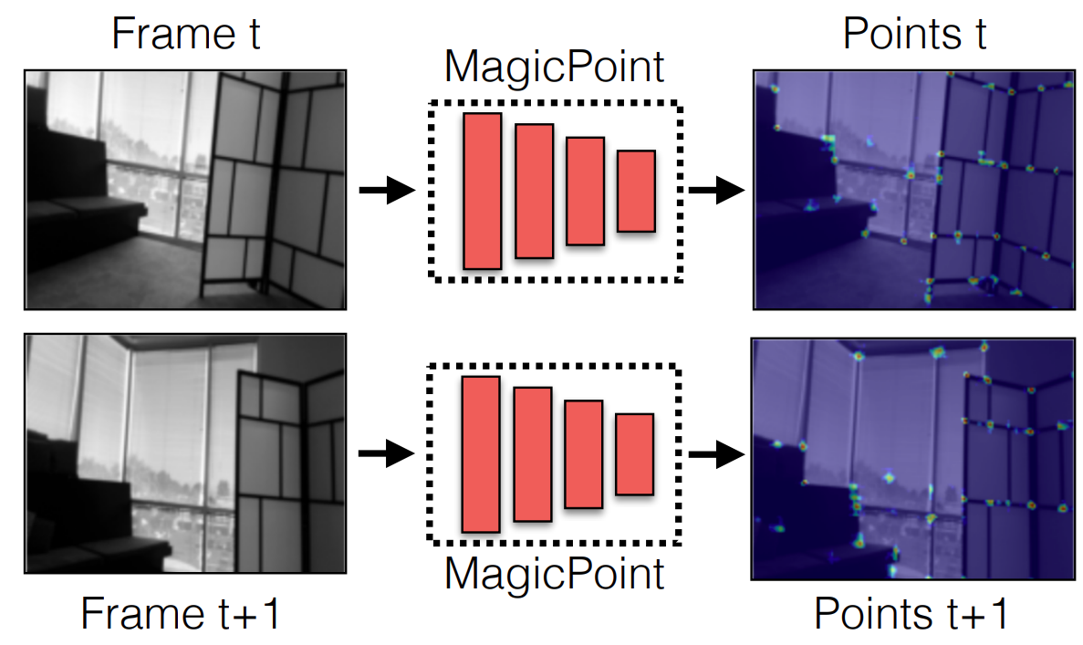
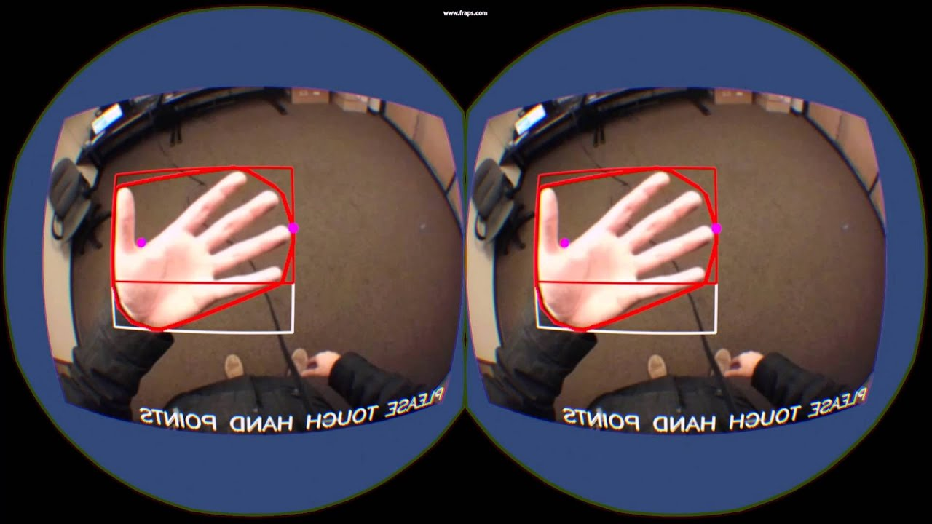
What makes XR different?
Spatial sensors are critical path for operation
[DeTone et al., 2017]
Vive Hand Tracking

Slide 6
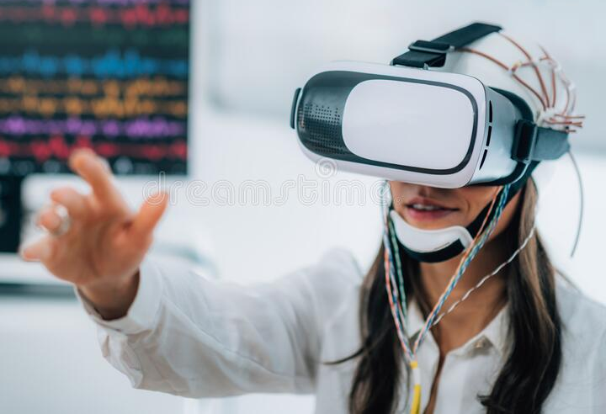
What makes XR different?
Spatial sensors are critical for device operation
Novel sensors that track the user
EMG, EEG, Gaze, Pupil,
Heart Rate, GSR, fNIRS
Samsung Galaxy S21

Slide 7
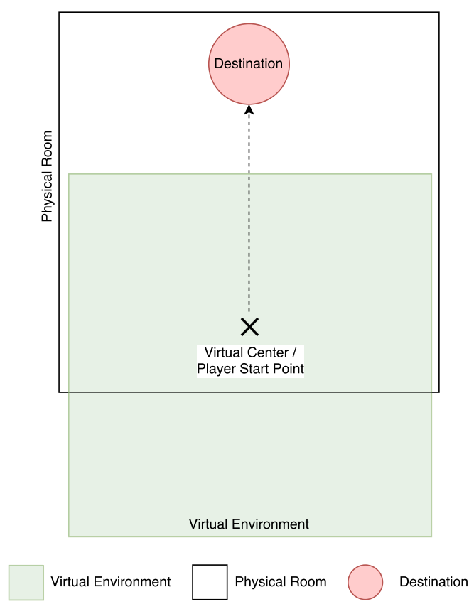
What makes XR different?
Spatial sensors are critical for device operation
Novel sensors that track the user
Perceptual judgements can be altered
[Casey et al., 2019]

Slide 8
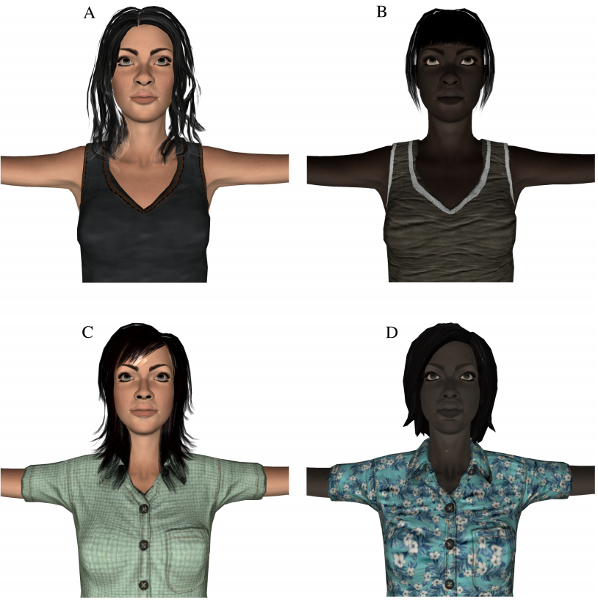
What makes XR different?
Spatial sensors are critical for device operation
Novel sensors that track the user
Perceptual judgements can be altered
Avatars that represent us
[Hasler et al., 2017]

Slide 9
Conclusion
Privacy and security challenges for the future of XR are unique
Bridge XR and S&P communities to tackle these challenges
Website: https://jainlab.cise.ufl.edu/PrXR_2021.html
Contact Email: brendanjohn@ufl.edu

