Slide 1
A privacy-preserving approach to streaming eye-tracking data
Brendan David-John
University of Florida
Diane Hosfelt
Mozilla*
*currently at Appley
Kevin Butler
University of Florida
Eakta Jain
University of Florida
Web: www.jainlab.cise.ufl.edu/Privacy_and_Security_in_Eye_Tracking.html Email: brendanjohn@ufl.edu

Slide 2
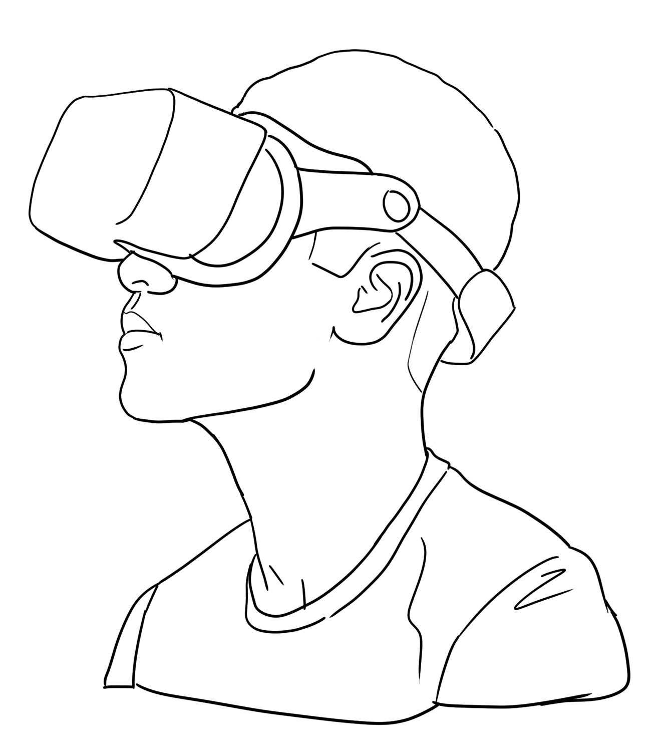
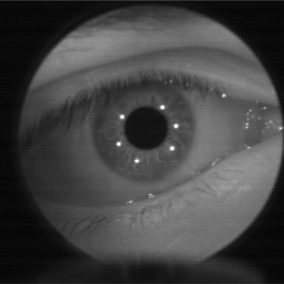
Motivation
Aggregate-level:
Area-of-interest Analysis
Event-level:
Redirected Walking
User X
Gaze Data Stream
<x, y, t>
Sample-level: Foveated Rendering
Applications
Sample-level: Biometric Identity
Event-level:
Health Conditions
Aggregate-level: Sexual Orientation
Eye Tracker

Slide 3
Key Contribution
Establish a framework for streaming eye-tracking data to support mixed reality applications while mitigating risks given a threat model.
Scenario 1: Applications that require aggregate/event-level data
Threat: Sample-level data
Solution: Gatekeeper API
Scenario 2: Applications that require sample-level data
Threat: Biometric Identification by Colluding Apps
Solution: Privacy Mechanisms

Slide 4
Background
Protect What Users Look at
Protect Aggregate Features
[Li et al., 2021]
[Liu et al., 2019], [Steil et al., 2019], [Bozkir et al., 2020]
Protect Iris Biometric
Eye Movement Biometrics
[John et al., 2019], [Bozkir et al., 2020],
[Choudhary et al., 2020]
[Schröder et al., 2020]

Slide 5
Scenario 1: Aggregate/Event Data
Aggregate-level
AOI Metrics, Dwell Time
360◦ Video
Safety Training
Gatekeeper
(Browser, API)
User X
Gaze Data Stream
<x, y, t>
Gatekeeper
API
Eye Position, e.g., (x, y, t)
Redirected Walking
Eye Image
Event-level,
Saccade/Blink
Gaze-based Interface
Event-level,
Fixation duration
Eye Tracker
Threat Model:
Trusted Platform, Protect Sample-level Data

Slide 6
Scenario 2: Sample Data
Sample Data
Foveated Rendering
Gaze Prediction
User Identity Known
<x, y, t>
User X
Gaze Data Stream
<x, y, t>
Sample-level Applications
Eye Position, e.g., (x, y, t)
App Collusion
User X identified as pro-Union
Eye Image
Social VR
Eye Animation
User Identity Unknown
Sample Data
<x, y, t>
Eye Tracker
Threat Model:
Trusted Platform, Reduce User Identification

Slide 7
Solution: Privacy Mechanism
Modified Sample Data
Foveated Rendering
Gaze Prediction
User Identity Known
<x’, y’, t’>
User X
Gaze Data Stream
<x, y, t>
Privacy Mechanism
Eye Position, e.g., (x, y, t)
App Collusion
User X identified as pro-Union
Eye Image
Social VR
Eye Animation
User Identity Unknown
Modified Sample Data
<x’, y’, t’>
Eye Tracker
Threat Model:
Trusted Platform, Untrusted Applications

Slide 8
Evaluation
Datasets:
ET-DK2 (360◦ Images)
19 Individuals, 50 Stimuli
VR-Saliency (360◦ Images)
130 Individuals, 8 Stimuli
VR-EyeTracking (360◦ Images)
43 Individuals, 148 Stimuli
360_em (360◦ Images)
13 Individuals, 14 Stimuli
DGaze (3D Rendered Scenes)
43 Individuals, 2 Stimuli
New Dataset
Mechanisms:
Additive Gaussian Noise
Temporal Downsample
Spatial Downsample
Metric:
Identification Rate
$$\frac{\# Stimuli Correctly Predicted}{Total \# of Stimuli in Test Set}$$

Slide 9
Privacy-Utility Trade-off: Gaze Prediction

Slide 10
Summary
A Gatekeeper model can be used to protect biometric features in gaze data streams for many applications.
Standalone privacy mechanisms can be applied for applications when sample-level data is needed.
Takeaway: Privacy-preserving frameworks are necessary to address threats to privacy from behavioral data in mixed reality.

Slide 11
Thanks!
Please read our paper and visit the website for more details.
Web: www.jainlab.cise.ufl.edu/Privacy_and_Security_in_Eye_Tracking.html
PrXR Workshop: www.jainlab.cise.ufl.edu/PrXR_2021.html
Email: brendanjohn@ufl.edu

