Slide 1




The Security-Utility Trade-off for Iris Authentication and Eye Animation for Social Virtual Avatars
Brendan David-John
PhD Student
University of Florida
Sophie Jörg
Associate Professor
Clemson University
Sanjeev Koppal
Assistant Professor
University of Florida
Eakta Jain
Assistant Professor
University of Florida
Web: www.jainlab.cise.ufl.edu/Privacy_and_Security_in_Eye_Tracking.html Email: brendanjohn@ufl.edu

Slide 2
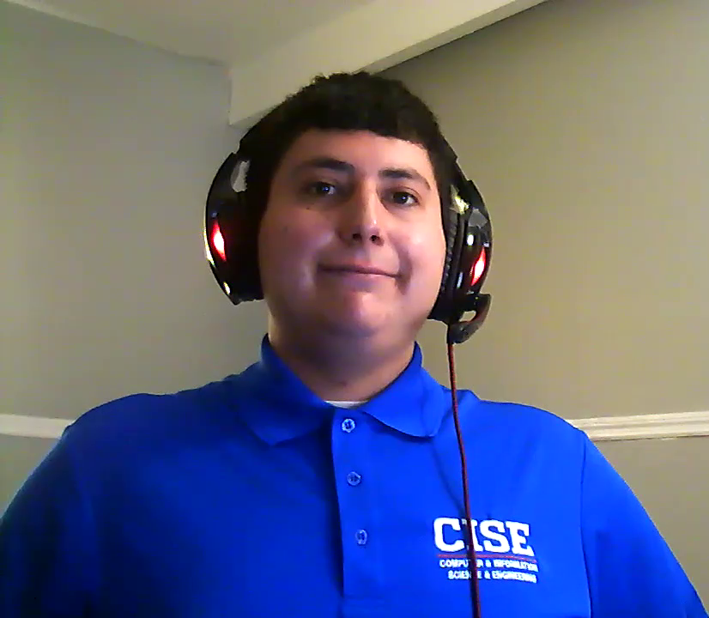
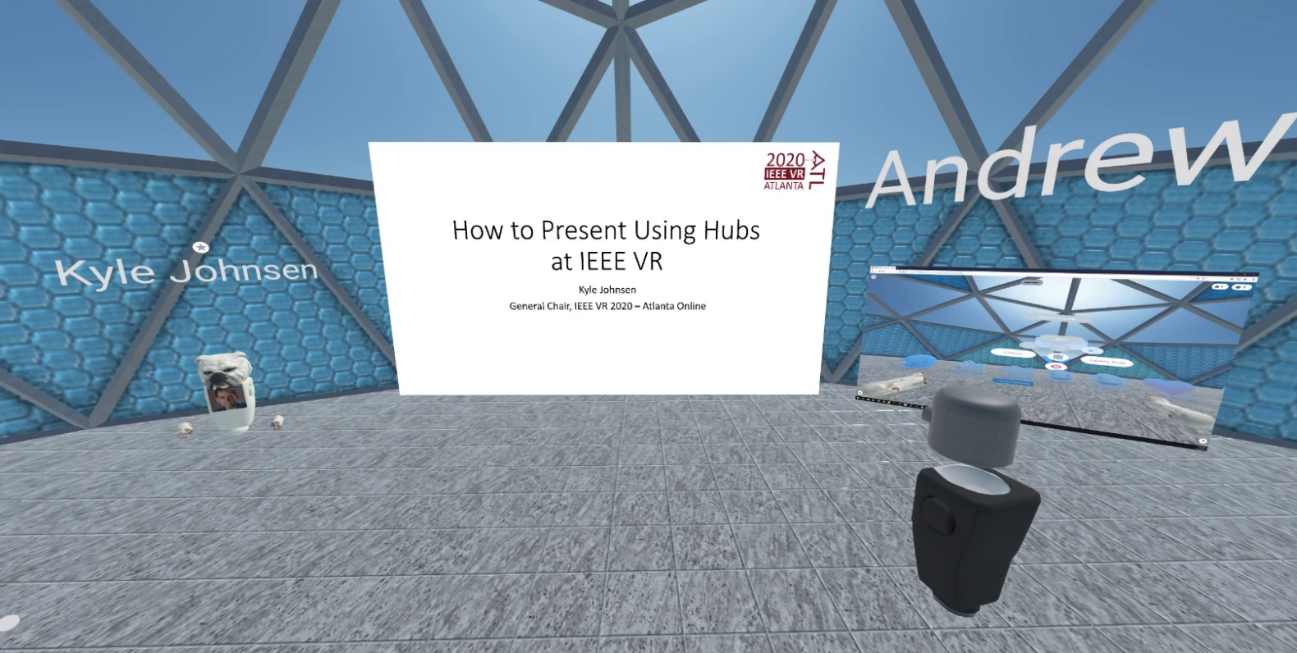
Introduction
hubs.mozilla.com - Hubs by Mozilla

Slide 3
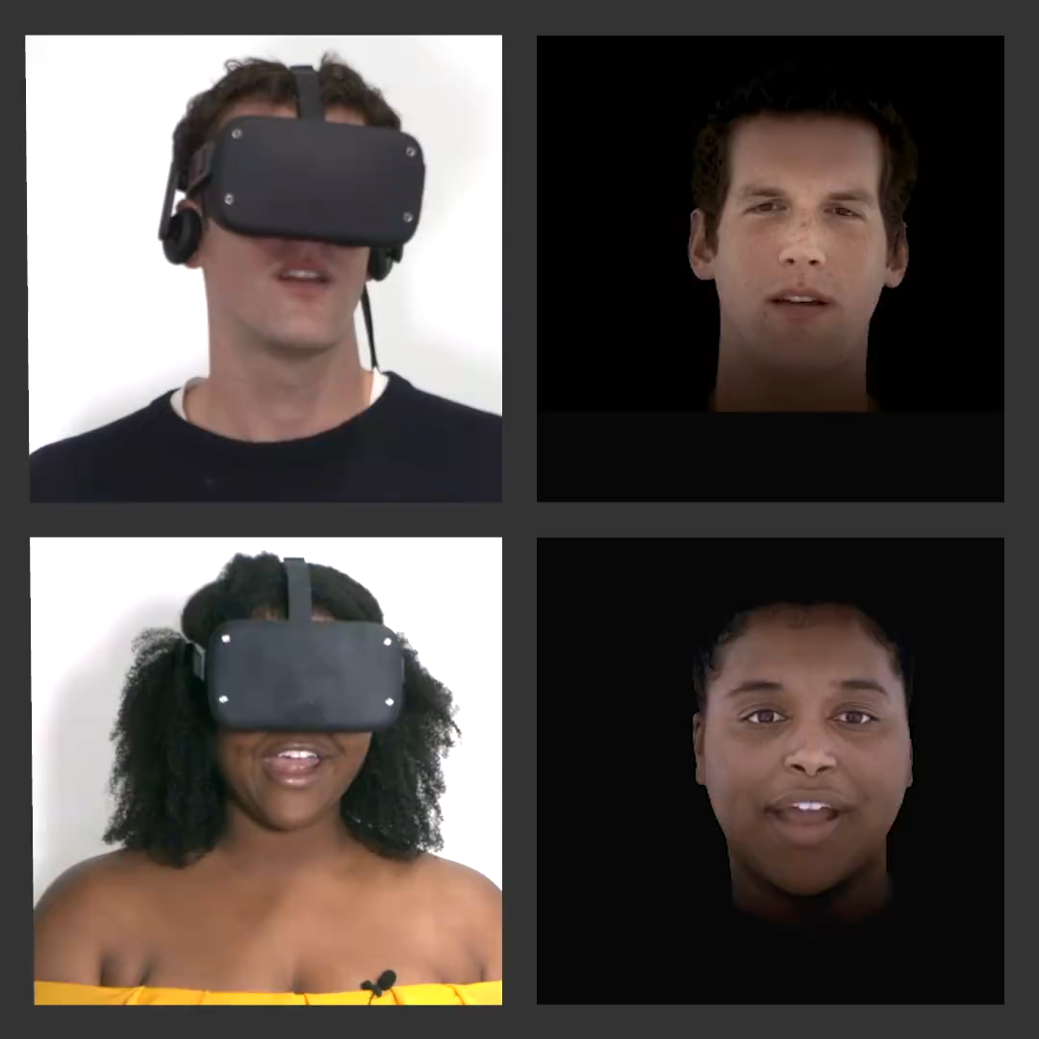
Video by TECH@Facebook™
“Codec Avatars: Conversation in VR”
https://tech.fb.com/codec-avatars-facebook-reality-labs/

Slide 4
Threat Model
Untrusted Eye Tracking Platform/System
Adversary wants to steal your password to spoof login
EX: Adversary gains access to data port used by eye camera
The iris biometric is stolen and used to access secure account

Slide 5
Related Work
Augmented Reality: Malicious inputs/outputs
  [Jana et al., IEEE SP’13 & USENIX’13] , [Lebeck et al., IEEE SP’17 & ’18]
Wearables: Privacy of bystanders
  [Neustaedter et al., ACM TOCHI’06], [Hasan et al., ACM CHI’18]
Eye Tracking: Privacy of the scene camera and gaze datasets
  [Liu et al., ACM ETRA’19 ], [Steil et al., ACM ETRA’19]
Our Prior Work: Secure iris biometric within eye image
  [John et al., ACM ETRA’19]

Slide 6
Research Problem
How might we transform the eye image to “turn off” the biometric, i.e., to secure iris signature?

Slide 7
Separable in Frequency Domain
Glint
Iris
Iris
Pupil

Slide 8
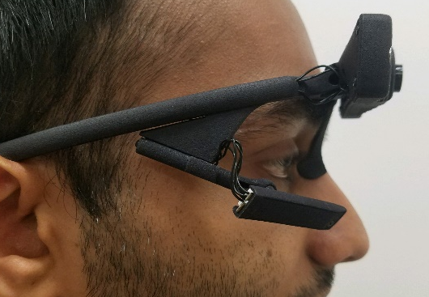
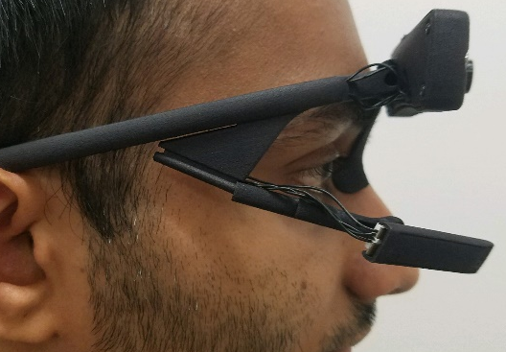
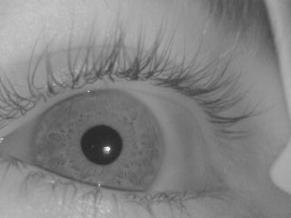
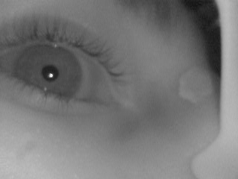
Key Insight: Optical Defocus
In-Focus Configuration
Out-of-Focus Configuration
Tele-scoping
Arm
Increased
Eye Distance
Eye Camera

Slide 9
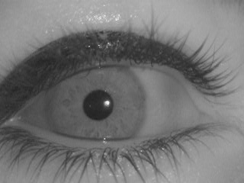


Contribution: How much blur?
σ = 0 pixels
σ = 3 pixels
σ = 8 pixels
Gaze error = 1.4º
CRR = 79%
Gaze error = 1.9º
CRR = 5%
Gaze error = N/A
CRR = 0%

Slide 10
Security-Utility Tradeoff
Security: Iris Recognition
Utility: Gaze Accuracy
Out-of-focus
In-focus
5% CRR

Slide 11
Contribution: Perceptual Studies
RQ₁ : At what level of blur do viewers notice a difference in the animation of an avatar’s eyes relative to a reference?
[Detection Threshold/PSE]
RQ₂ : What is the relationship between level of blur and the avatar’s perceived naturalness, truthfulness, attentiveness?
[Perceived attributes]

Slide 12
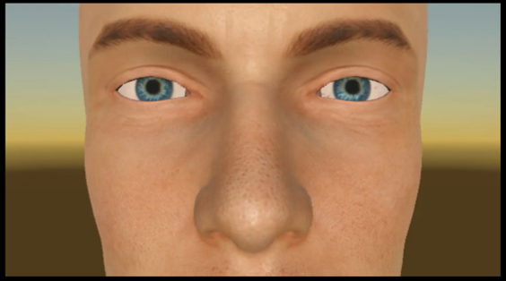
Stimuli Generation
Conversational gaze data
Gaze directions transferred to an avatar
Eye images sent through software blur
Gaze directions from blurred images transferred to an avatar

Slide 13
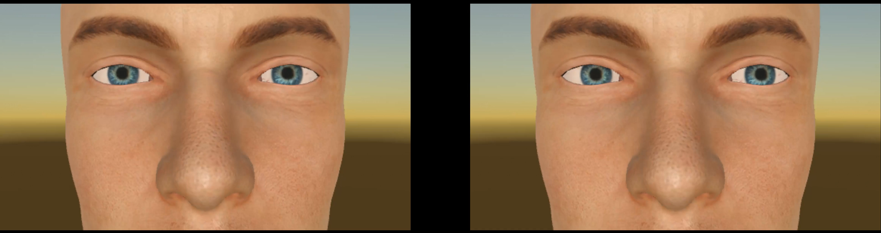
Stimuli Generation
σ = 5 pixels

Slide 14
RQ₁ : At what level of defocus do viewers notice a difference in the animation of an avatar’s eyes relative to a reference?
Method: 20 participants shown reference avatar and avatar with eye movements estimated from secure eye images.
Asked “Are they same or different?”
PSE
CRR<5%
DT
CRR<2%

Slide 15
RQ₂ : What is the relationship between level of defocus and the avatar’s perceived attributes?
Method: 19 different participants shown one avatar at a time; Asked to provide a rating on a 5-point Likert scale,
e.g., “The avatar was truthful.”
Truthfulness
Naturalness
Attentiveness
Comfort
Eye Contact

Slide 16
What about Social VR?
Attentiveness
Truthfulness
5% CRR
Takeaway: Change in perceived attributes for 𝞂 > 3.
Less than 5% chance of your iris image being usable for identity theft when 3<𝞂<5.
Recommendation: Use a blur kernel with 𝞂<5.

Slide 17
Summary
How might we transform the eye image to “turn off” the biometric, i.e., to secure iris signature?
Takeaway 1: Use defocus
Takeaway 2: in software or hardware
Takeaway 3: but select parameters while considering impact on perceived attributes of your avatar

Slide 18
Limitations and Future Work
Perceptual Studies
This experiment:
  Avatar eyes are the only animated portion
  Perceptual study does not consider the impact of blur on blink detection or pupil diameter estimates
This framework:
  Assumes an eye tracker camera with adjustable focus
  Recommended “sweet spot” in the security-utility tradeoff applies to a fixed iris authentication method
Design Framework
Adversarial Learning

Slide 19

Thanks!
Please read our paper and visit the website for more details.
Web: www.jainlab.cise.ufl.edu/Privacy_and_Security_in_Eye_Tracking.html
Email: brendanjohn@ufl.edu

Slide 20
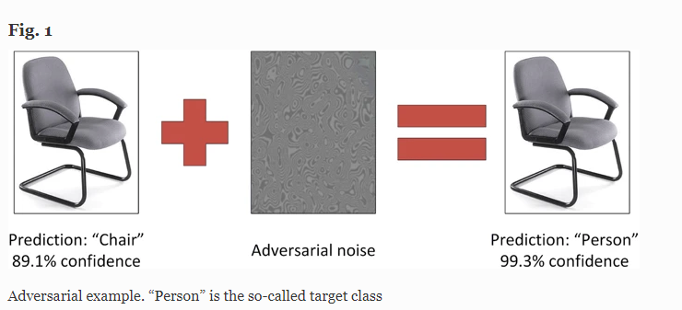
Limitations and Future Work
Perceptual Studies
This experiment:
  Avatar eyes are the only animated portion
  Perceptual study does not consider the impact of blur on blink detection or pupil diameter estimates
This framework:
  Assumes an eye tracker camera with adjustable focus
  Recommended “sweet spot” in the security-utility tradeoff applies to a fixed iris authentication method
Design Framework
Adversarial Learning
[Denis et al., International Journal of Machine Learning and Cybernetics, 2020]
Notes:
Our experiment had some limitations, namely only the eyes were animated, which means no blinks, pupil changes, or head movements. To address this in future work we can conduct experiments with more interactive avatars.
Our framework for hardware blur assumes that the user can access the eye tracking camera, however this is not always the case with VR displays. *click* to address this we can consider new optics solutions.
But the one that I am most interested in, is addressing this key limitation of the current work. We have presented a sweet spot for a fixed iris auth method, and we selected this as it is a standard. PPl are coming up with new solutions all of the time, including deep networks,

Slide 21


Key Insight: Optical Defocus = Low Pass Filter
In-Focus Configuration
Out-of-Focus Configuration
Increased
Lens-eye distance
Telescoping Arm
Eye Camera
Notes:
[TODO: Don’t use the VR eye images, use from past slides with an in-focus and out-of-focus even from EyeVeil]
We propose the use of a blur filter to remove the iris signature from the eye image. Blur can be applied in software by convolving with a blur kernel such as Gaussian blur as seen in this video stream. <click> Blur can also be applied in hardware through optical defocus. For this work we add defocus by increasing the distance between the eye camera and the user’s eye. This allows the user to control their own security, and allows them to enable and disable the iris biometric as needed.
Highlight concept of in-focus and out-of-focus configuration

