Slide 1
A PRELIMINARY BENCHMARK OF FOUR SALIENCY ALGORITHMS ON COMIC ART
Khimya Khetarpal ¹ & Eakta Jain ²
University of Florida
Department of ECE ¹, Department of CISE ²
Notes:
Hello Everyone, Welcome to the presentation on <A Preliminary Benchmark of Four Saliency Algorithms on Comic Art> presented by myself Khimya Khetarpal, co-authored by <Dr Eakta Jain> from University of Florida.
Starting with Visual Saliency in Comic Art .

Slide 2
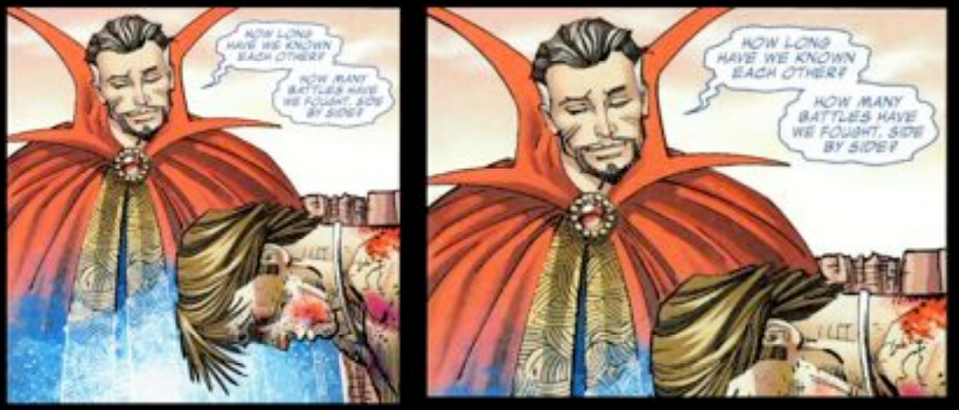
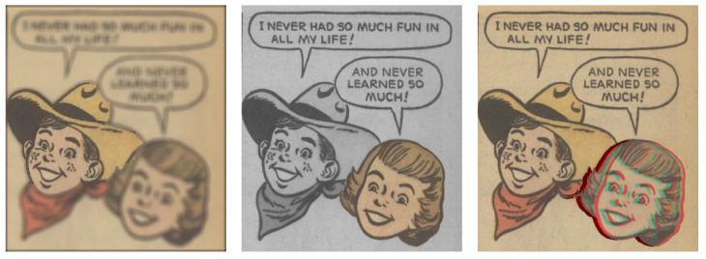
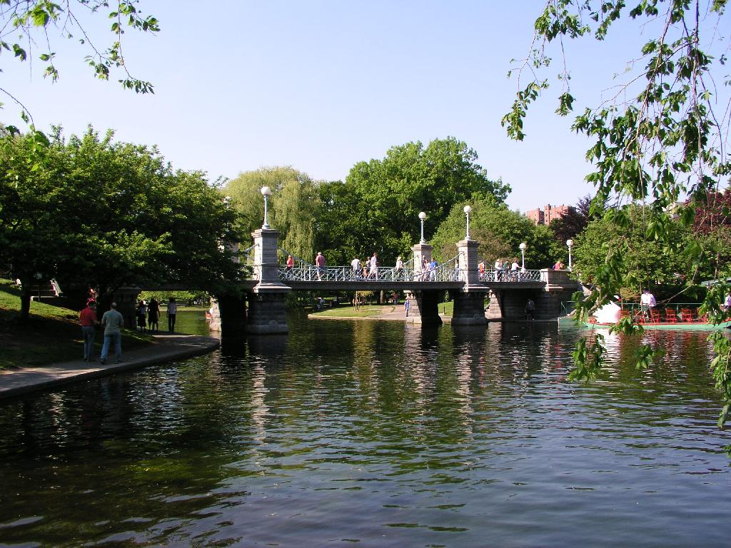
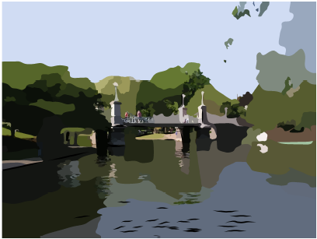
Visual Saliency in Comic Art
Jain et al., IEEE CG&A Special Issue 16-to appear
Thirunarayanan et al., ACM SAP Poster 16
Judd et al., ICCV 09
Notes:
There are several applications where it is useful to segment out important regions in Comic Art –
For example: creating effects on moves in stills as shown by Jain et. al,
Adding effects like Defocusing, Recoloring and Stereoscopy, to drive the narrative as shown by Thirunarayanan et al
And even applications such as painterly rendering as shown by Judd et al (point out)
If there was a visual saliency method that work well on comic art – then all of these types of applications could use it as an intermediate step ,
And this is the MOTIVATION for our paper .
We benchmark four existing saliency models on comic art -

Slide 3
Outline
3
Benchmark of four existing saliency models on comic art
Data-driven approach - Judd et al., ICCV 09 (LSVM)
Graph based bottom-up saliency model - Harel et al., NIPS 06 (GBVS)
Difference of Gaussian based bottom up algorithm - Frintrop et al., CVPR 15 (VOCUS2)
Region contrast based salient object detection - Cheng et al., PAMI 15 (RC)
Notes:
Based on their popularity and recent findings we chose
Judd et al’s ICCV 2009 model which we will refer as LSVM
Harel ‘s NIPS, 2006 model which we will refer as GBVS
Frintrop et al ‘s CVPR 2015 termed VOCUS2 by the authors and
Cheng et al PAMI 2015 model - which is termed RC

Slide 4
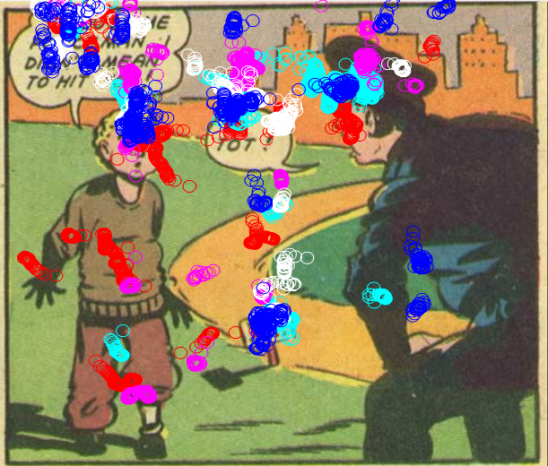
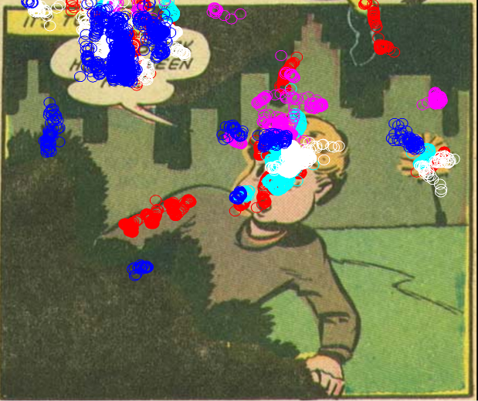
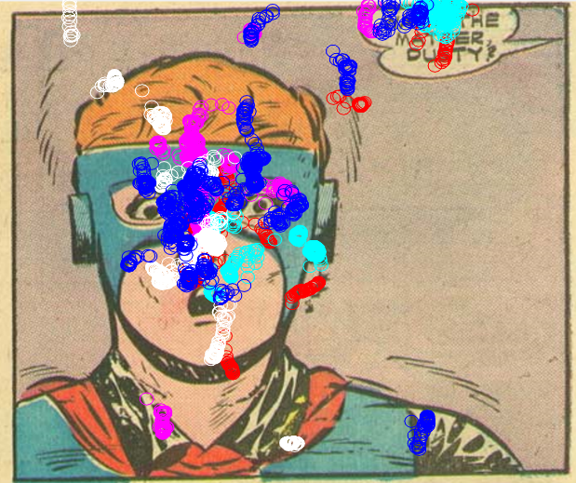
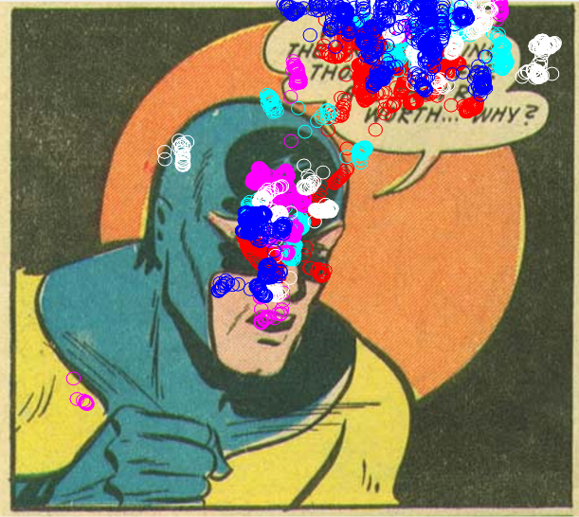
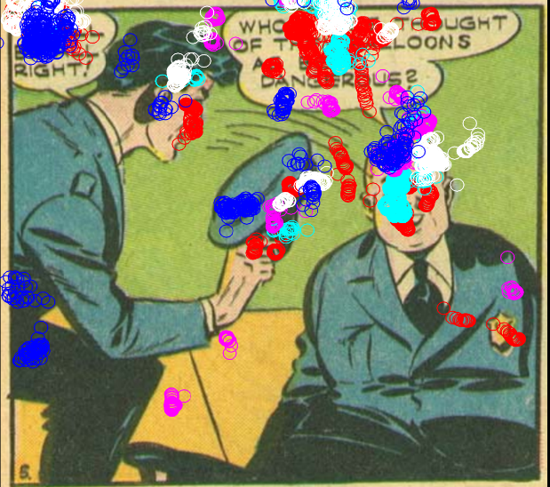
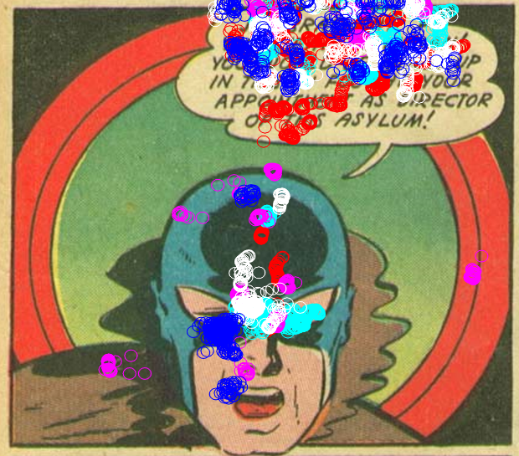
Eye Tracking Data – Comic Images
4
Eye tracking data collected by Thirunarayanan et al., ACM SAP Poster 16
23 comic images
5 viewers (3 male)
Notes:
We use the eye tracking data collected by Thirunarayanan et al
The data consists of 23 comic images taken from public domain legacy comics
Data was recorded for 5 viewers (3 male and 2 female)
I want to point out the colored circles here overlaid on these sample images is data from 5 viewers alone --- yet there is a large amount of consistency between these fixations
As you can observe, all 5 viewers gazed a lot over the text –
Almost all images show consensus among viewers that they looked a characters' faces

Slide 5
Our Test Setup – Outline
5
Models
Image Categories
Eye Tracking Data
Metrics
LSVM
GBVS
VOCUS2
RC
Comics
CAT2000
Outdoor Natural
Outdoor Man-made
Social
Comics eyetracking
CAT2000
Training Data
Testing Data
Normalized Scanpath Saliency (NSS)
Area Under Curve (AUC)
CAT2000 [Borji et al., CVPR 15]
Notes:
(point out )
Our Test Setup comprises of
4 saliency models namely LSVM, GBVS, VOCUS2, and RC
Image categories including two datasets – Comics and CAT2000 .
Comic images are from our lab , where as CAT2000 dataset published by Borji et al in CVPR 2015
This dataset consists of 4000 images from 20 different categories . We randomly chose 3 out of 20 categories namely Outdoor Natural , Manmade and Social
Eye Tracking data consists of
Fixations of 5 observers for 23 comic images
And Fixations of 18 observers for training images
We evaluate our setup on two metrics namely NSS and AUC

Slide 6
Our Test Setup – Phase I
Models
Image Categories
Eye Tracking Data
Metrics
LSVM
GBVS
VOCUS2
RC
Comics
CAT2000
Outdoor Natural
Outdoor Man-made
Social
Comics eyetracking
CAT2000
Training Data
Testing Data
Normalized Scanpath Saliency (NSS)
Area Under Curve (AUC)
CAT2000 [Borji et al., CVPR 15]
Notes:
In Phase I, we evaluate all 4 models on the 3 chosen image categories from CAT2000 dataset – on their publicly available Training Data
Spend a lot of time – go slow – point out with your hand ---

Slide 7
Our Test Setup – Phase I
Normalized Scanpath Saliency [NSS] | Outdoor ManMade | Outdoor Natural | Social | Overall
LSVM | 1.22 (0.22) | 1.28 (0.21) | 1.21 (0.19) | 1.24 (0.21)
GBVS | 1.11 (0.28) | 1.17 (0.34) | 1.14 (0.27) | 1.14 (0.3)
RC | 0.88 (0.29) | 0.92 (0.28) | 0.83 (0.23) | 0.88 (0.27)
VOCUS2 | 0.73 (0.32) | 0.75 (0.29) | 0.81 (0.26) | 0.76 (0.29)
Notes:
We observe the following results for NSS – the numbers here represent mean values with standard deviation in brackets
- It is observed that Judd et al’s saliency model outperforms the other three models on NSS
Harel’s GBVS ranks second, performing marginally close to Judd et al’s model of saliency
Cheng at al’s RC and Frintrop’s VOCUS2 ranks 3rd and 4th respectively

Slide 8
Our Test Setup – Phase I
8
Normalized Scanpath Saliency [NSS] | Outdoor ManMade | Outdoor Natural | Social | Overall
LSVM | 1.22 (0.22) | 1.28 (0.21) | 1.21 (0.19) | 1.24 (0.21)
GBVS | 1.11 (0.28) | 1.17 (0.34) | 1.14 (0.27) | 1.14 (0.3)
RC | 0.88 (0.29) | 0.92 (0.28) | 0.83 (0.23) | 0.88 (0.27)
VOCUS2 | 0.73 (0.32) | 0.75 (0.29) | 0.81 (0.26) | 0.76 (0.29)
Area Under Curve [AUC] | Outdoor ManMade | Outdoor Natural | Social | Overall
LSVM | 0.83 (0.04) | 0.84 (0.04) | 0.83 (0.05) | 0.83 (0.04)
GBVS | 0.79 (0.06) | 0.79 (0.05) | 0.79 (0.05) | 0.79 (0.05)
RC | 0.72 (0.06) | 0.73 (0.73) | 0.72 (0.63) | 0.72 (0.07)
VOCUS2 | 0.68 (0.09) | 0.67 (0.08) | 0.70 (0.07) | 0.68 (0.08)
Notes:
We observe the following trend in performance on the second metric AUC.
LSVM is reported to outperform other 3 models in AUC as well
GBVS ranks second
RC and VOCUS2 are ranked 3rd and 4th respectively
The order of performance is mirrored in both metrics NSS and AUC as we can see here.
This trend is the same as what has been reported in published literature.
At this point we concluded that since the lit reports the same – we have all models set up fine.

Slide 9
Our Test Setup – Benchmark
9
Models
Image Categories
Eye Tracking Data
Metrics
LSVM
GBVS
VOCUS2
RC
Comics
CAT2000
Outdoor Natural
Outdoor Man-made
Social
Comics eyetracking
CAT2000
Training Data
Testing Data
Normalized Scanpath Saliency (NSS)
Area Under Curve (AUC)
Notes:
We then benchmark these models of saliency on our Comics Dataset
We evaluate the models again on NSS and AUC

Slide 10
Our Test Setup – Benchmark
10
NSS | CAT2000 | Comics
LSVM | 1.24 (0.21) | 0.88 (0.32)
GBVS | 1.14 (0.3) | 0.87 (0.44)
RC | 0.88 (0.27) | 0.64 (0.34)
VOCUS2 | 0.76 (0.29) | 0.59 (0.34)
AUC | CAT2000 | Comics
LSVM | 0.83 (0.04) | 0.72 (0.10)
GBVS | 0.79 (0.05) | 0.71 (0.10)
RC | 0.72 (0.07) | 0.66 (0.12)
VOCUS2 | 0.68 (0.08) | 0.65 (0.12)
Notes:
It is observed that LSVM performs better for natural images from the CAT2000 dataset than comic images in our dataset not only on NSS but also on AUC

Slide 11
Our Test Setup – Benchmark
11
NSS | CAT2000 | Comics
LSVM | 1.24 (0.21) | 0.88 (0.32)
GBVS | 1.14 (0.3) | 0.87 (0.44)
RC | 0.88 (0.27) | 0.64 (0.34)
VOCUS2 | 0.76 (0.29) | 0.59 (0.34)
AUC | CAT2000 | Comics
LSVM | 0.83 (0.04) | 0.72 (0.10)
GBVS | 0.79 (0.05) | 0.71 (0.10)
RC | 0.72 (0.07) | 0.66 (0.12)
VOCUS2 | 0.68 (0.08) | 0.65 (0.12)
Notes:
GBVS is also reported to perform better on natural images than comic data for both NSS and AUC metrics

Slide 12
Our Test Setup – Benchmark
12
NSS | CAT2000 | Comics
LSVM | 1.24 (0.21) | 0.88 (0.32)
GBVS | 1.14 (0.3) | 0.87 (0.44)
RC | 0.88 (0.27) | 0.64 (0.34)
VOCUS2 | 0.76 (0.29) | 0.59 (0.34)
AUC | CAT2000 | Comics
LSVM | 0.83 (0.04) | 0.72 (0.10)
GBVS | 0.79 (0.05) | 0.71 (0.10)
RC | 0.72 (0.07) | 0.66 (0.12)
VOCUS2 | 0.68 (0.08) | 0.65 (0.12)
Notes:
We see the same pattern for RC

Slide 13
Our Test Setup – Benchmark
13
NSS | CAT2000 | Comics
LSVM | 1.24 (0.21) | 0.88 (0.32)
GBVS | 1.14 (0.3) | 0.87 (0.44)
RC | 0.88 (0.27) | 0.64 (0.34)
VOCUS2 | 0.76 (0.29) | 0.59 (0.34)
AUC | CAT2000 | Comics
LSVM | 0.83 (0.04) | 0.72 (0.10)
GBVS | 0.79 (0.05) | 0.71 (0.10)
RC | 0.72 (0.07) | 0.66 (0.12)
VOCUS2 | 0.68 (0.08) | 0.65 (0.12)
Notes:
And also for VOCUS2 .

Slide 14
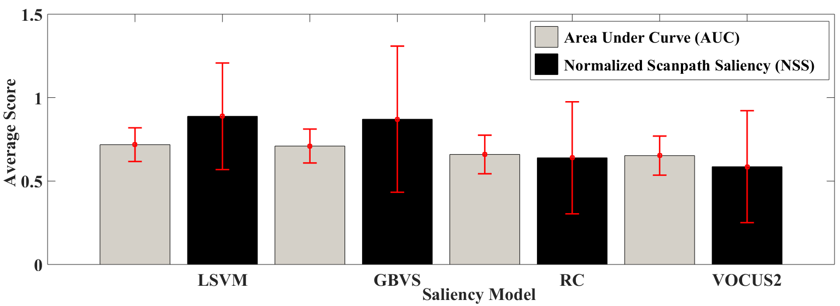
Our Test Setup – Benchmark
14
NSS | CAT2000 | Comics
LSVM | 1.24 (0.21) | 0.88 (0.32)
GBVS | 1.14 (0.3) | 0.87 (0.44)
RC | 0.88 (0.27) | 0.64 (0.34)
VOCUS2 | 0.76 (0.29) | 0.59 (0.34)
AUC | CAT2000 | Comics
LSVM | 0.83 (0.04) | 0.72 (0.10)
GBVS | 0.79 (0.05) | 0.71 (0.10)
RC | 0.72 (0.07) | 0.66 (0.12)
VOCUS2 | 0.68 (0.08) | 0.65 (0.12)
Notes:
Overall, we see here the NSS and AUC scores for Comics has the same order of performance .
The key takeaway here being : All 4 models of saliency in our benchmark report lower scores on Comic Art as compared to the natural image categories in CAT2000 dataset.

Slide 15
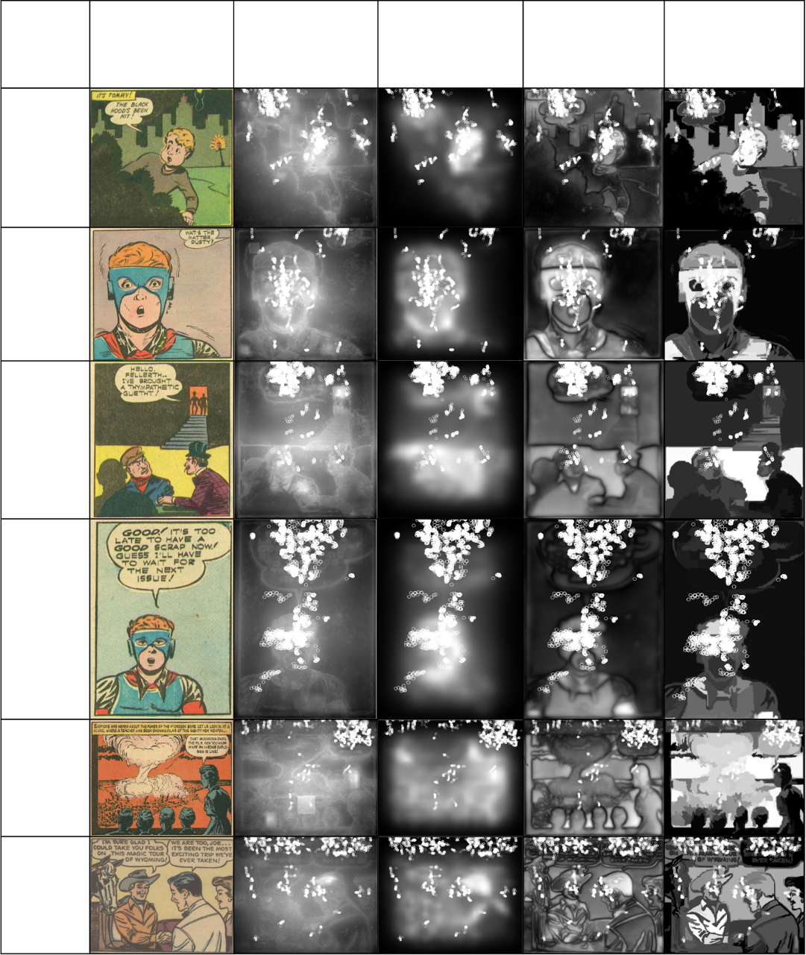
Experiment & Evaluation
15
Gaze data from 5 participants is overlaid using white circles on the saliency maps
Notes:
- To understand the results better – let us look at the saliency maps were generated from all 4 models on randomly chosen 6 comic images
Shall we keep less images ??
Mention 20 as examples talking about all faces not marked salient

Slide 16
Conclusion
16
LSVM is a leading candidate for visual saliency on comic art
Notes:
One might wonder – Why does LSVM perform so well on comic images, when it is a data-driven model trained on natural images that (on the first glance) are not “comic like” in style ?

Slide 17
Discussion
17
Why does LSVM model perform so well on comic images ?
Notes:
One might wonder – Why does LSVM perform so well on comic images, when it is a data-driven model trained on natural images that (on the first glance) are not “comic like” in style ?
Looking into this model

Slide 18
Exploratory Analysis
18
Cars [30]
High Level
People [31]
Faces [32]
Mid Level
Horizon Line [29]
Center Prior
Distance to center [33]
Steerable Pyramids [1-13]
Color [16]
3D Histograms to find the Prob. of a color [23-27]
Low Level
Intensity [14]
Values of R, G, B [17-19]
Orientation [15]
Prob. of R, G, B [20-22]
Torralba Saliency [28]
Judd et al., ICCV 09
Notes:
THE LSVM model has a number of feature channels , a total of 33.
These are ranging from low level feature channels such as 13 channels of steerable pyramids , 1 channel of intensity, color, and orientation each, 6 channels of R G B values etc.
To mid level to high level features including faces, people, and cars
-As part of LSVM ‘ s training process – they assign weights to each feature channel –
-The more weighted feature channels are contributing more to the LSVM model
Considering the weights learned by LSVM --- for each feature channel -----We find the 3 most weighted features to be

Slide 19
Exploratory Analysis
19
Cars [30]
High Level
People [31]
Faces [32]
Mid Level
Horizon Line [29]
Center Prior
Distance to center [33]
Steerable Pyramids [1-13]
Orientation [16]
3D Histograms to find the Prob. of a color [23-27]
Low Level
Color [14]
Values of R, G, B [17-19]
Intensity [15]
Prob. of R, G, B [20-22]
Torralba Saliency [28]
Judd et al., ICCV 09
Notes:
We find the 3 most weighted features to be
coefficients of the second coarsest sub-band of steerable pyramids - i.e. Channel 12
Features used in a saliency model described by Torralba – Channel 28
Color contrast as calculated by Itti and Koch’s saliency method - - Channel 14
Question : When we plotted the weights out , we find the weights drop significantelly after these 4 features --

Slide 20
Exploratory Analysis
20
Hypothesis I : Comic panels in our dataset are similar to natural images in LSVM’s dataset in terms of features used for saliency prediction
Notes:
We hypothesize that - Comic panels in our dataset are similar to natural images in LSVM’s dataset in terms of features used for saliency prediction
To find evidence for this Hypothesis , we conducted the following experiment

Slide 21
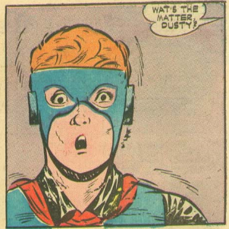
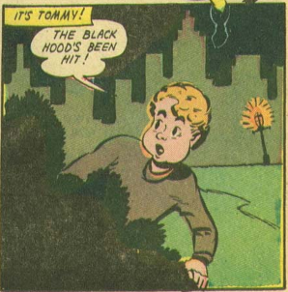
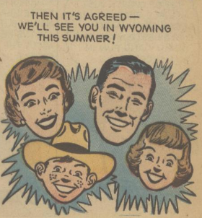
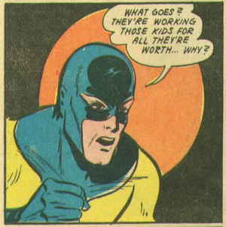
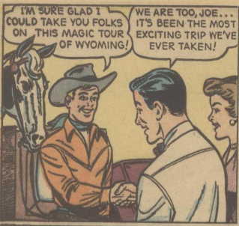
Exploratory Analysis
21
Hypothesis I : Comic panels in our dataset are similar to natural images in LSVM’s dataset in terms of features used for saliency prediction
23 Comic Images
Notes:
This is our Comic Dataset – consisting of 23 such images

Slide 22
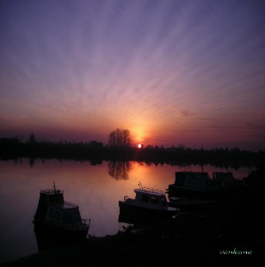
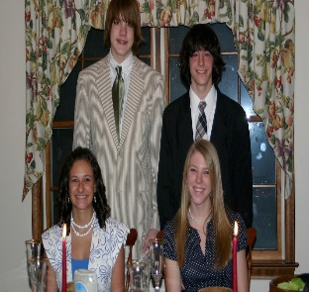
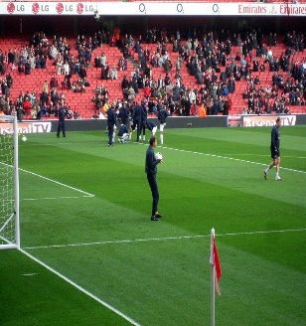
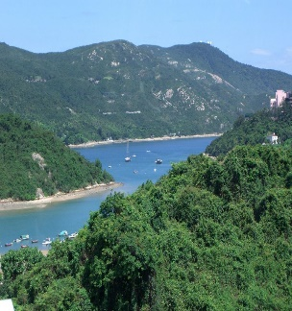
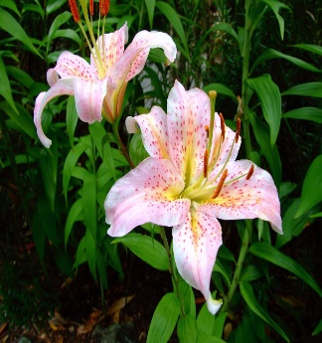
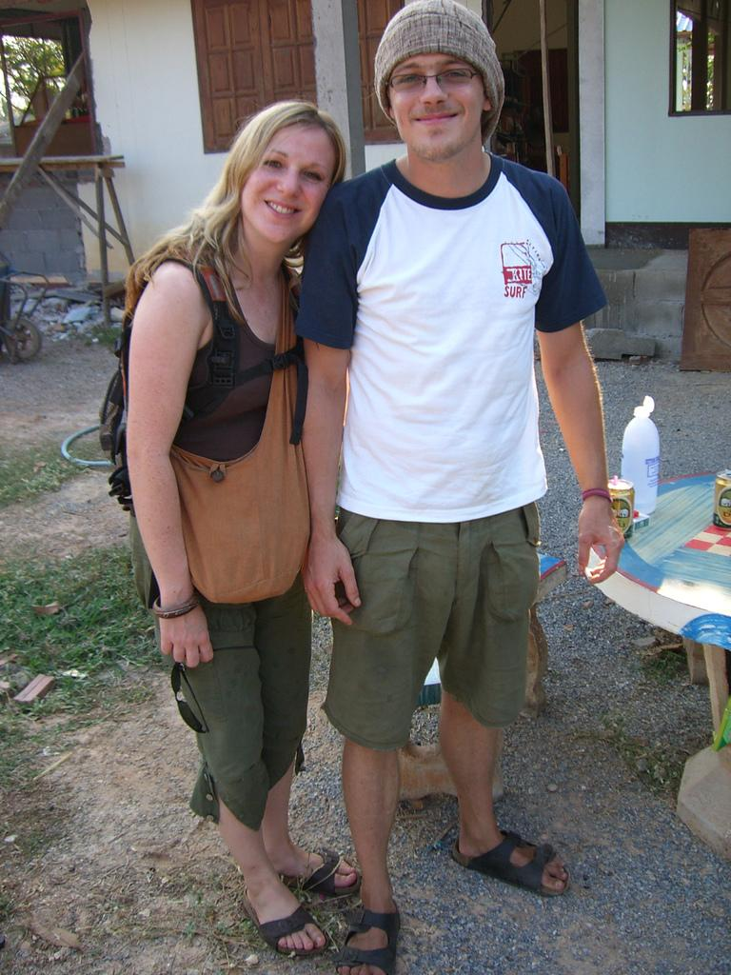
Exploratory Analysis
22
Hypothesis I : Comic panels in our dataset are similar to natural images in LSVM’s dataset in terms of features used for saliency prediction
23 Comic Images
1003 Natural Images
Notes:
Where as this is a dataset used by LSVM for training and testing their model – consisting of 1003 natural images

Slide 23
Exploratory Analysis
23
Hypothesis I : Comic panels in our dataset are similar to natural images in LSVM’s dataset in terms of features used for saliency prediction
3 most weighted feature channels are chosen
23 Comic Images
1003 Natural Images
Notes:
We take the 3 most weighted feature channels

Slide 24
Exploratory Analysis
24
Hypothesis I : Comic panels in our dataset are similar to natural images in LSVM’s dataset in terms of features used for saliency prediction
3 most weighted feature channels are chosen
23 Comic Images
Computation of feature vectors using the implementation in LSVM
1003 Natural Images
Notes:
We use the implementation in LSVM to compute feature vectors for 1003 images from the LSVM dataset and 23 images from our comic dataset.

Slide 25
Exploratory Analysis
25
Hypothesis I : Comic panels in our dataset are similar to natural images in LSVM’s dataset in terms of features used for saliency prediction
3 most weighted feature channels are chosen
23 N*N
.. N*N
23 Comic Images
2 N*N
1 N*N
Computation of feature vectors using the implementation in LSVM
Feature Vectors
1 N*N
1003 Natural Images
2 N*N
.. N*N
1003 N*N
Notes:
Resulting in 1003 and 23 Feature Vectors for both datasets respectively

Slide 26
Exploratory Analysis
26
Hypothesis I : Comic panels in our dataset are similar to natural images in LSVM’s dataset in terms of features used for saliency prediction
23 N*N
.. N*N
2 N*N
1 N*N
23 Comic Images
Computation of feature vectors using the implementation in LSVM
1 N*N
1003 Natural Images
2 N*N
.. N*N
1003 N*N
Notes:
So far, we obtain Feature Vectors for both comic and natural images

Slide 27
Exploratory Analysis
27
Hypothesis I : Comic panels in our dataset are similar to natural images in LSVM’s dataset in terms of features used for saliency prediction
23 N*N
.. N*N
2 N*N
1 N*N
23 Comic Images
Computation of feature vectors using the implementation in LSVM
Euclidean Distance
23
1003
1 N*N
1003 Natural Images
2 N*N
.. N*N
1003 N*N
Notes:
We then compute the distances between comic and natural images in feature space, using Euclidean distance.
Each element in the resulting 23 * 1003 matrix holds the pairwise distance score.

Slide 28
Exploratory Analysis
28
Hypothesis I : Comic panels in our dataset are similar to natural images in LSVM’s dataset in terms of features used for saliency prediction
23 N*N
.. N*N
2 N*N
1 N*N
23 Comic Images
Computation of feature vectors using the implementation in LSVM
Euclidean Distance
23
1003
1 N*N
1003 Natural Images
2 N*N
Averaged across all comic images
.. N*N
1003 N*N
1*1003
Notes:
These scores are then averaged across all 23 comic images, resulting in a 1 * 1003 vector .
This represents the average distance between comic and natural images

Slide 29
Exploratory Analysis
29
Hypothesis I : Comic panels in our dataset are similar to natural images in LSVM’s dataset in terms of features used for saliency prediction
1003 N*N
.. N*N
2 N*N
1 N*N
1003 Natural Images
Computation of feature vectors using the implementation in LSVM
Euclidean Distance
1003
1003
1 N*N
1003 Natural Images
2 N*N
Averaged across all natural images
.. N*N
1003 N*N
1*1003
Notes:
Similarly, we compute pairwise distances between natural images,
Averaged across all natural images, resulting in a average distance vector of 1 * 1003 dimension. This represents the average distance between pool of natural images

Slide 30
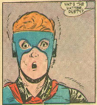
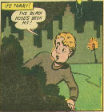
Exploratory Analysis
30
Hypothesis I : Comic panels in our dataset are similar to natural images in LSVM’s dataset in terms of features used for saliency prediction
1*1003
1003 Natural Images
Average distance between natural and natural images
Similarity Score
Average distance between comic and natural images
23 Comic Images
1*1003
1003 Natural Images
Notes:
To quantify similarity between comic images and natural images in a particular feature space,
we define a Similarity score as the difference between (Average distance between natural images) and (Average distance between natural and comic images)

Slide 31
Exploratory Analysis
31
Hypothesis I : Comic panels in our dataset are similar to natural images in LSVM’s dataset in terms of features used for saliency prediction
Higher similarity
1*1003
1003 Natural Images
Average distance between natural and natural images
High Positive
Similarity Score
Negative
Average distance between comic and natural images
23 Comic Images
Low Similarity
1*1003
1003 Natural Images
Notes:
With this definition A high positive score indicates comic images were relatively more similar to natural images than the amount natural images are similar to other natural images.
Whereas A negative score depicts --comic images are quite different from natural images
Question --- scenario
If the difference is high → the lower box is smaller - > this means that comic images are closer to natural images → Hence this difference formed our choice of defining similarity score ( Of course all this for the feature being considered )
There are 1003 natual images – they could be pretty diff from each other – for example a sunset is very diff from a portrait

Slide 32
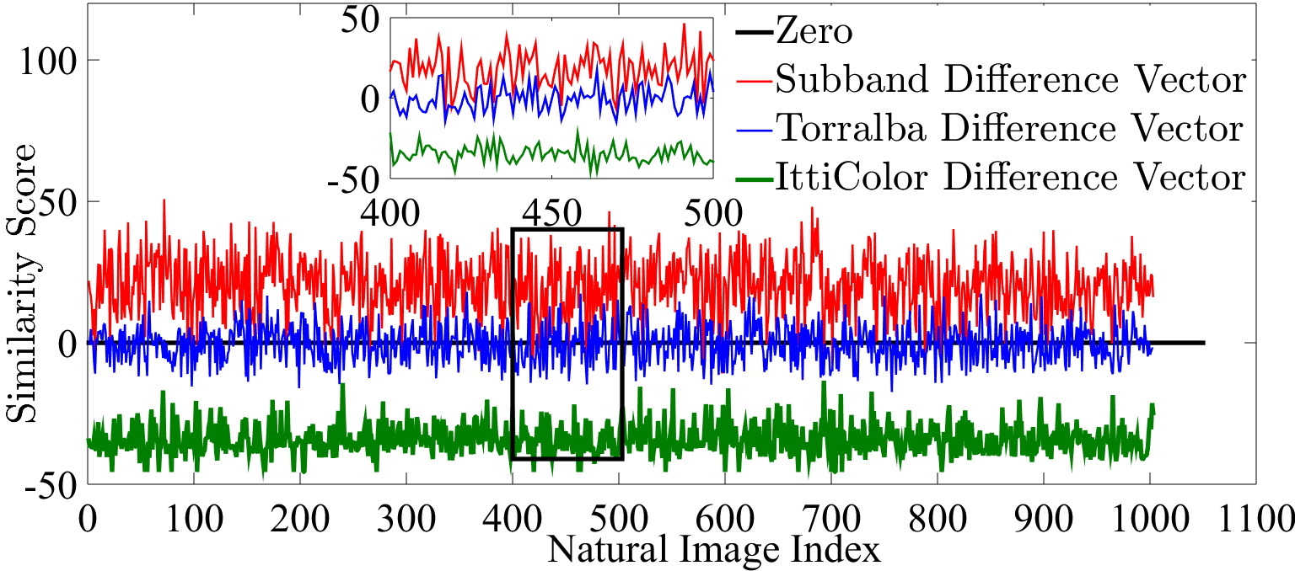
Exploratory Analysis
32
Hypothesis I : Comic panels in our dataset are similar to natural images in LSVM’s dataset in terms of features used for saliency prediction
Similarity between natural and comic images in context of 3 out of 33 features from LSVM model of saliency
Notes:
As a result we obtain the following result –
- A High positive score using second coarsest sub-band from steerable pyramids as feature, shows higher similarity between comic and natural images, relative to the similarity among natural images.
- On the other hand , using Torralba saliency as feature resulted in showing similarity between comic and natural images to be of the same order as natural images were to other natural images.
-The plot below the zero line, indicates comic images were a lot different from natural images, when Itti’s color channel was used as feature.
Why only these features – We restricted ourselves to the most contributing features in the LSVM saliency model .

Slide 33
Exploratory Analysis
33
Cars [30]
High Level
People [31]
Faces [32]
Mid Level
Horizon Line [29]
Center Prior
Distance to center [33]
Steerable Pyramids [1-13]
Orientation [16]
3D Histograms to find the Prob. of a color [23-27]
Low Level
Color [14]
Values of R, G, B [17-19]
Intensity [15]
Prob. of R, G, B [20-22]
Torralba Saliency [28]
Notes:
Our second exploratory analysis which consider a high level feature “FACES”

Slide 34
Exploratory Analysis
34
Hypothesis II : Face detection algorithms used by saliency models work well for natural images but not for comic art
Notes:
- Based on models’ relatively lower performance on comic images, we hypothesize <Face detection algorithms used by saliency models work well for natural images but not for comic art.>

Slide 35
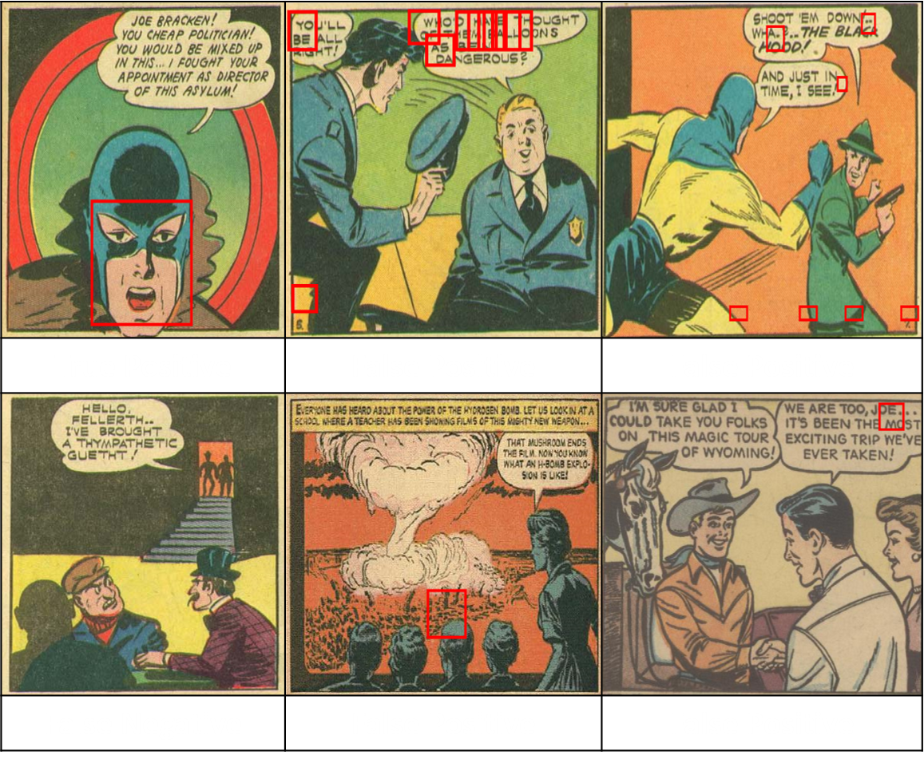
Exploratory Analysis
35
Hypothesis II : Face detection algorithms used by saliency models work well for natural images but not for comic art
Notes:
--Of the 40 faces in comic image data set, only 3 faces were detected correctly by Viola Jones face detector, whereas 29 detections were false positives.
-- It is fair to conclude that Faces in comic art are a lot different than those in natural images in style.
Extra Slides on VJ Face Detector – features used ?? – how are they different here ?? The same features do not have a discriminative power when it comes to comic art

Slide 36
Take Aways
36
Benchmarked four existing saliency algorithms on comic images performing a comparative analysis with two metrics
Models in our study have the same order of performance for both natural images as well as comic art – a data driven model outperforms all
All models show relatively lower performances on comic art – need for saliency models targeted for comics !
Faces in comic art are different in style than natural images - Feature engineering needed for visual saliency in comics
Notes:
-Key Takeaways from this work are:
We benchmarked 4 existing saliency algorithms on comic art – evaluating these models on two metrics NSS and AUC
We found that models in our study show the same order of performance on both natural and comic images – whereas a data driven model is seen to outperform other 3
Important to note that all models show relatively lower performance for comics in particular – indicating the need for better saliency models – especially aimed at comic art
Additionally, we saw faces in comic art are the same as those in natural images - Feature engineering potentially could cater to comic images in particular -

Slide 37
Future Work
37
Extension by comparing a bigger pool of saliency models existing in the literature
Evaluation of deep learning based saliency
More features and bigger datasets including manga images for example
Applying these saliency algorithms to the applications for comic art
Thank You
Notes:
-This work can be further extended by comparing a bigger pool of saliency models existing in the literature
-Evaluation of deep learning based saliency algorithms can give us a much deeper understanding of visual saliency in comic art
-Our explorations on similarity between natural and comic images could be extended to more features and larger datasets including manga images for example
- Applying these saliency algorithms to the applications for comic art has a lot of scope for this work in the future.
Yes we have done some work – manuscript in progress – conclusion is not good enough – useful direction of future work

Slide 38
Extra Slides
38

Slide 39
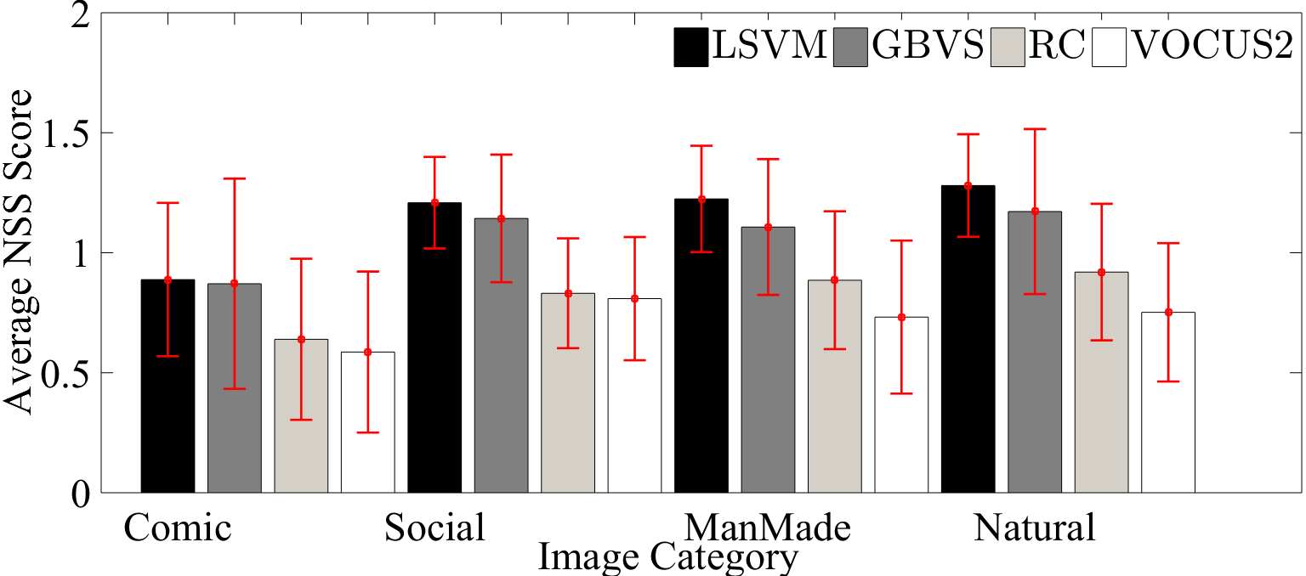
Performance Comparison - NSS
39
Mean NSS score where error bars are standard deviation
Notes:
This figure here depicts a summary of performance of all models on 4 image categories – As we discussed – this is evidence of the fact that existing saliency models perform relatively badly on comic art .

Slide 40
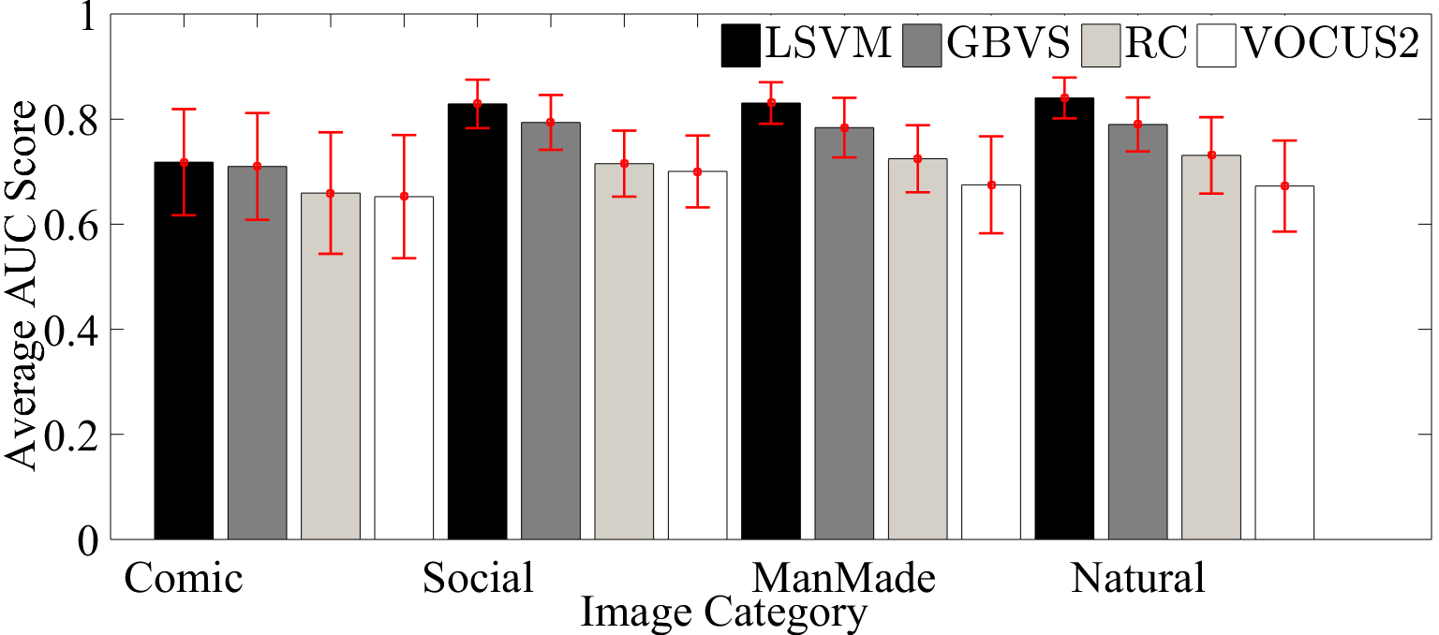
Performance Comparison – AUC
40
Mean AUC score with error bars as standard deviation
Notes:
This is further reinstated by results on AUC as well, concluding the need for saliency algorithms for comic art in particular !
Remove = extra slide

Slide 41
Our Test Setup – Phase I
41
NSS | ManMade | Natural | Social | Overall
LSVM | 1.22 (0.22) | 1.28 (0.21) | 1.21 (0.19) | 1.24 (0.21)
 | 1.27 (0.2) | 1.23 (0.21) | 1.18 (0.19) | 1.23 (0.2)
GBVS | 1.11 (0.28) | 1.17 (0.34) | 1.14 (0.27) | 1.14 (0.3)
 | 1.18 (0.34) | 1.06 (0.36) | 1.1 (0.32) | 1.11 (0.34)
MIT Saliency Benchmark
AUC | ManMade | Natural | Social | Overall
LSVM | 0.83 (0.04) | 0.84 (0.04) | 0.83 (0.05) | 0.83 (0.04)
 | 0.84 (0.04) | 0.84 (0.04) | 0.83 (0.04) | 0.84 (0.04)
GBVS | 0.79 (0.06) | 0.79 (0.05) | 0.79 (0.05) | 0.79 (0.05)
 | 0.8 (0.05) | 0.78 (0.06) | 0.79 (0.06) | 0.79 (0.06)
Data : CAT2000
Method | MSS | CA | LSVM | RC
AUC | 0.683 | 0.844 | 0.849 | 0.830
Cheng et al, PAMI 2015
Data : Judd et al
MSS Achanta et al, IEEE ICIP [2010]
CA Goferman et al, IEEE TPAMI [2012]
Notes:
We also validated our results by comparing the performance of Judd et al’s LSVM and Harel’s GBVS to the results on MIT Saliency Benchmark results on testing data

Slide 42
Saliency Models
42
LSVM
Hybrid of bottom up and top down
Employs 33 features ranging from low level to high level features
A Linear Support Vector Machine is trained using the eye tracking data itself
GBVS
Given an image I, GBVS uses a Markovian approach to compute activation maps from feature maps.
The second step; normalization aims at providing more weight to the salient regions, thus resulting in more informative saliency map.

Slide 43
Saliency Models
43
VOCUS2
A pyramid structure consisting of twin pyramids with multiple scales per layer
As opposed to one pyramid with one scale per layer used in iNVT model.
Features are computed in parallel,
center surround contrast is computed by difference-of-gaussians on different scales.
RC
In RC, the input image is first segmented into regions,
Then color contrast at the region level is computed, and finally saliency for each region is defined as the weighted sum of the regions contrasts to all other regions in the image.
The weights are set according to the spatial distances with farther regions being assigned smaller weights.

Slide 44
Normalized Scanpath Saliency
44
Each saliency map was linearly normalized to have zero mean and unit standard deviation.
The normalized saliency values were extracted corresponding to the fixation locations for each subject
The mean of these values was taken as a measure of the correspondence between the saliency map and Scanpath.
For each model, mean of all the five subjects’ NSS score results in the average NSS score for an image. The same is repeated to compute the mean NSS score for all four models across 23 comic images.
Notes:
To evaluate the performance of each model on comic images, we use Normalized Scanpath Saliency (NSS), as described in Peters, 2005.

Slide 45
Area Under Curve
45
A binary map with 1 corresponding to the fixation locations.
Jitter is introduced to saliency maps that come from saliency models that have a lot of zero values.
The saliency map is then normalized - values are then sorted to be used as threshold values.
Furthermore, true positive rate is calculated by ratio of the salience map values at fixation locations above the threshold, where as false positive rate is given by ratio of other salience map vales above threshold.
The AUC score is calculated by the area under the curve governed by true positive and false positive rates.
Notes:
We also report the performance of the models using another metric, Area Under the Curve (AUC). We use the implementation by Judd using her script

Slide 46
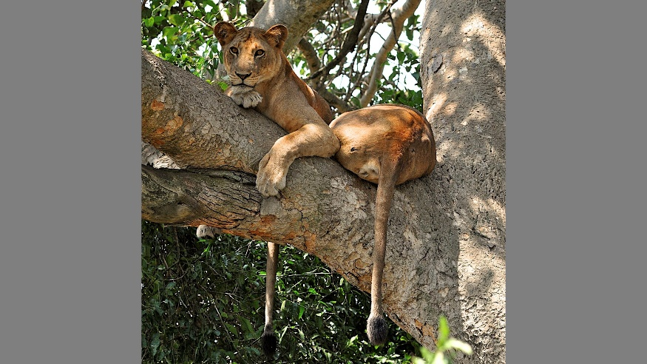
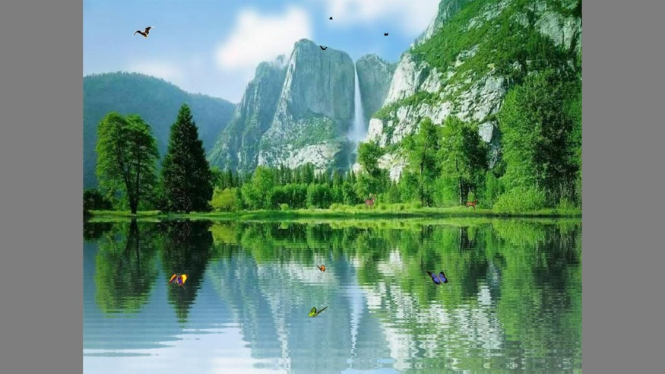
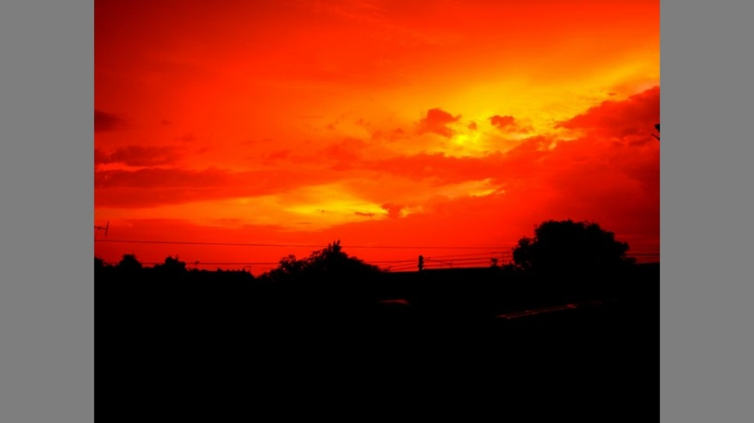
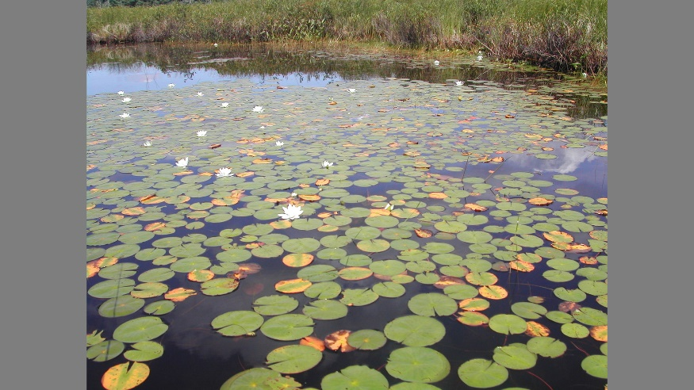
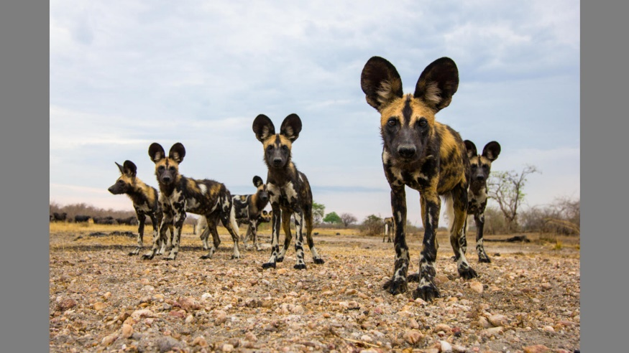
CAT2000
46
Outdoor Natural

Slide 47
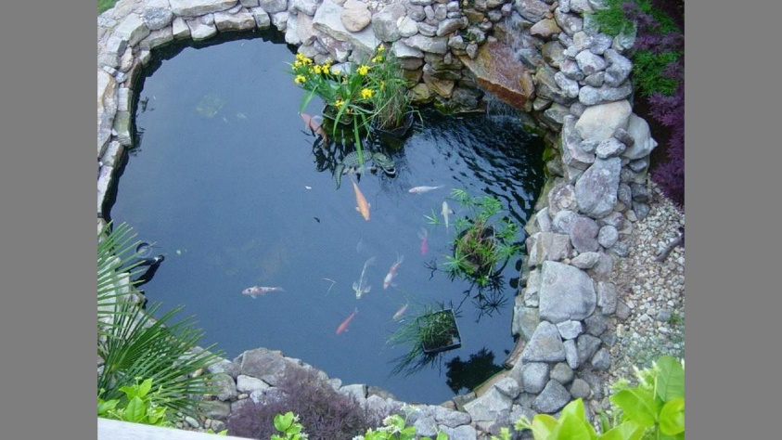
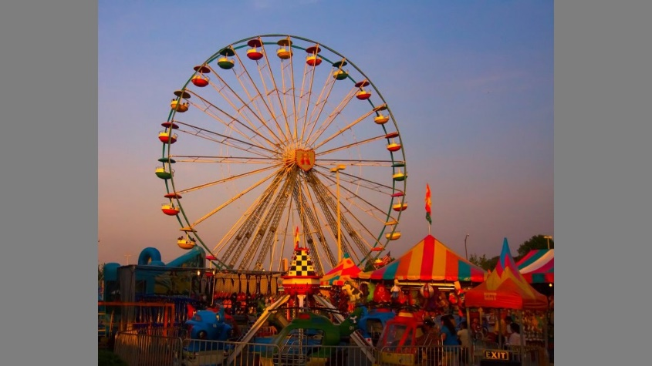
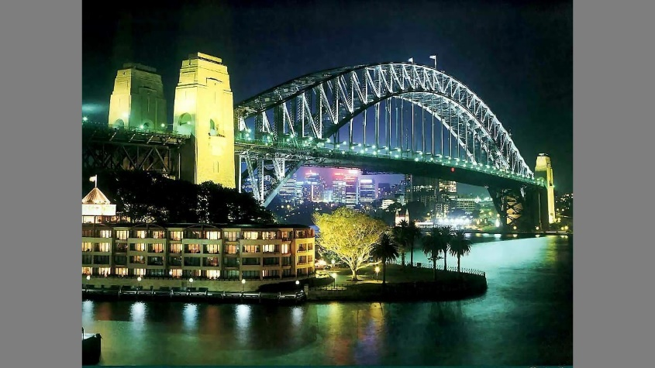
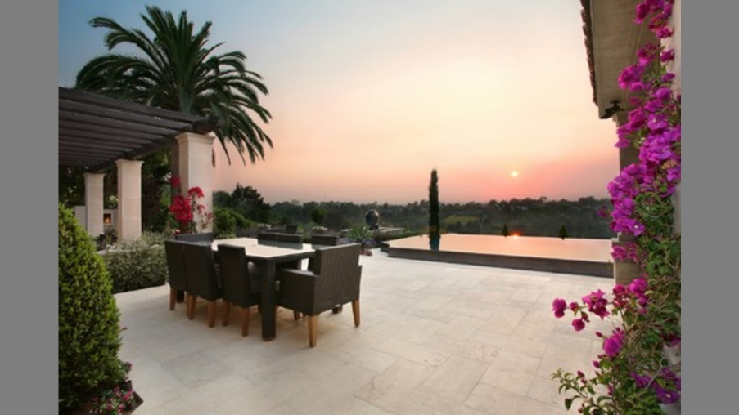
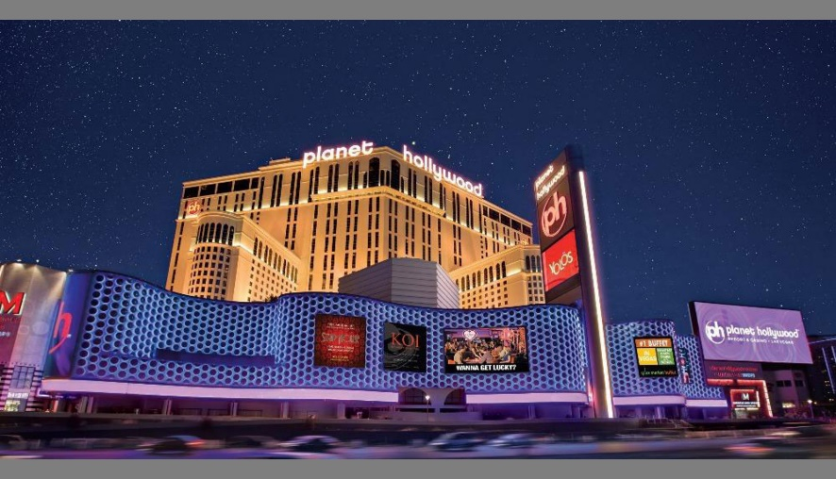
CAT2000
47
Outdoor Manmade

Slide 48
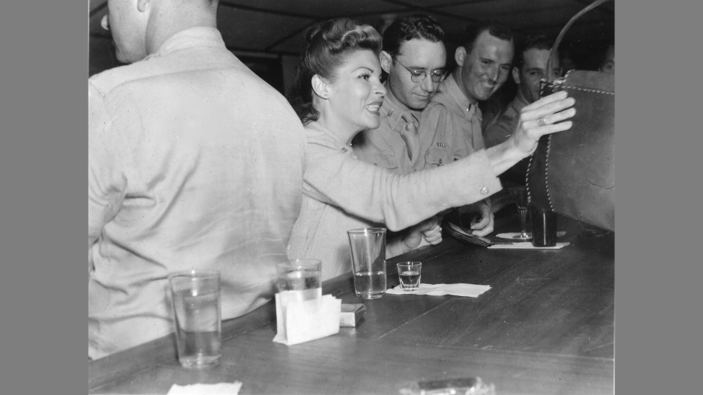
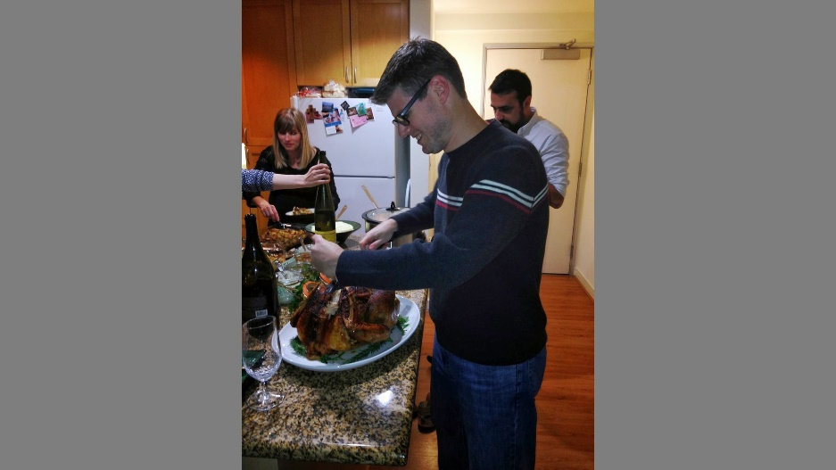
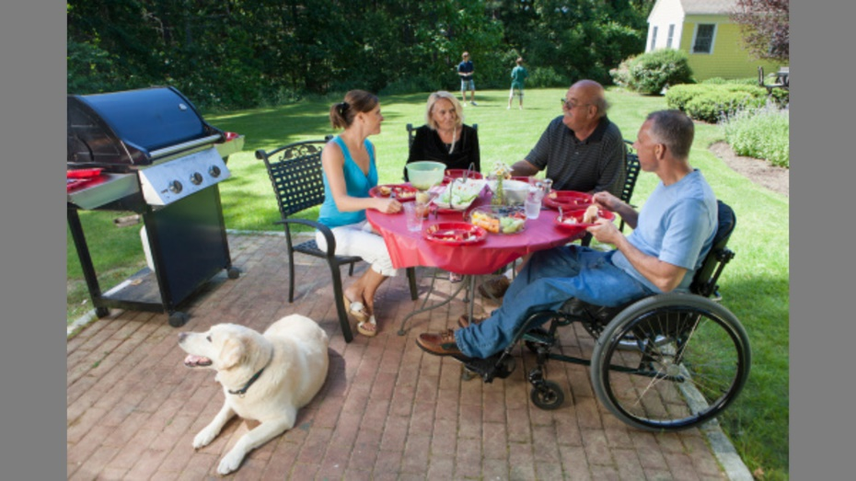
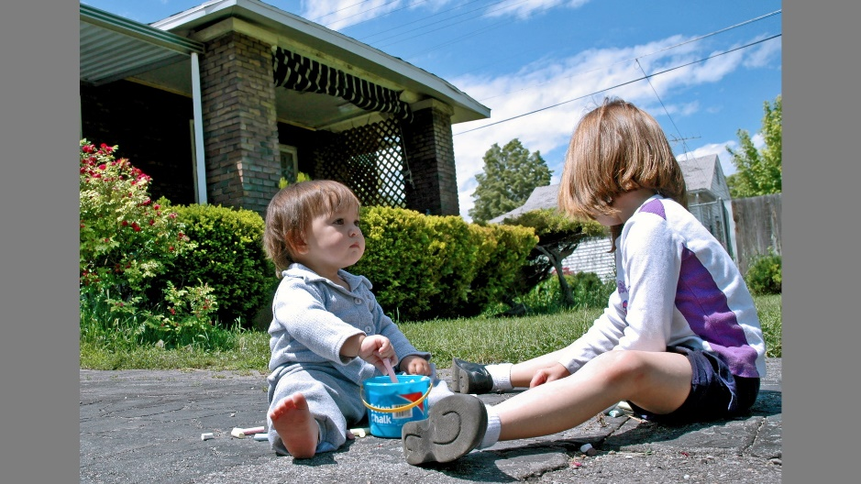
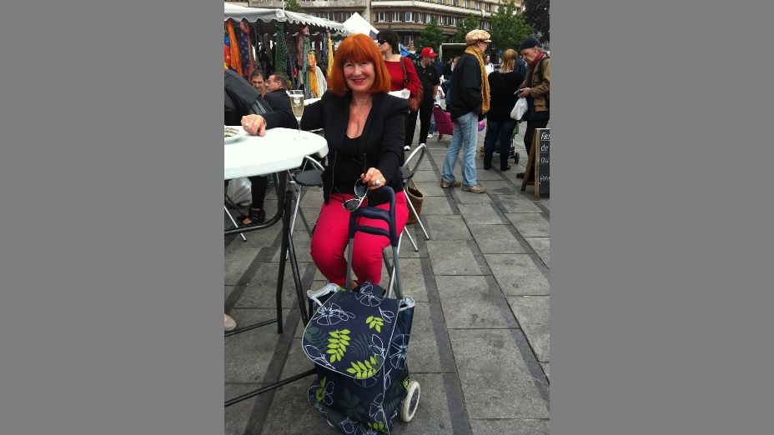
CAT2000
48
Social

